Slide 1
MYP 3 2019-20 Sciences
Handle the Pressure!
Mansi Gandhi
February 2020

Slide 2
Density:
Density = Mass/Volume
Effect of mass and volume on density
Density of regular and irregular objects
Density of liquids

Slide 3

You’ll need to put your heart into this unit! Don’t forget this image!

Slide 4
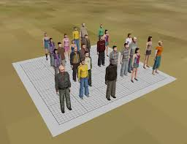
Volunteers Please!

Slide 5
Density is the amount of matter (mass) packed in a certain space (volume)

Slide 6
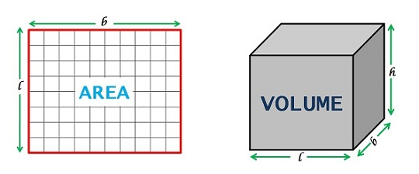
Area Vs. Volume

Slide 7
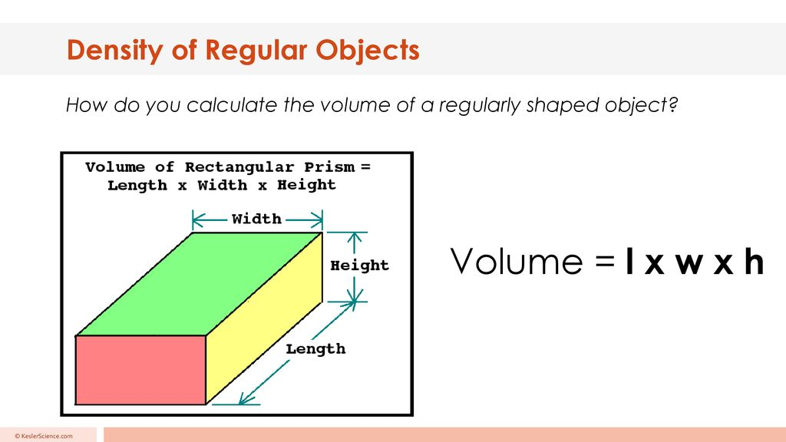

Slide 8
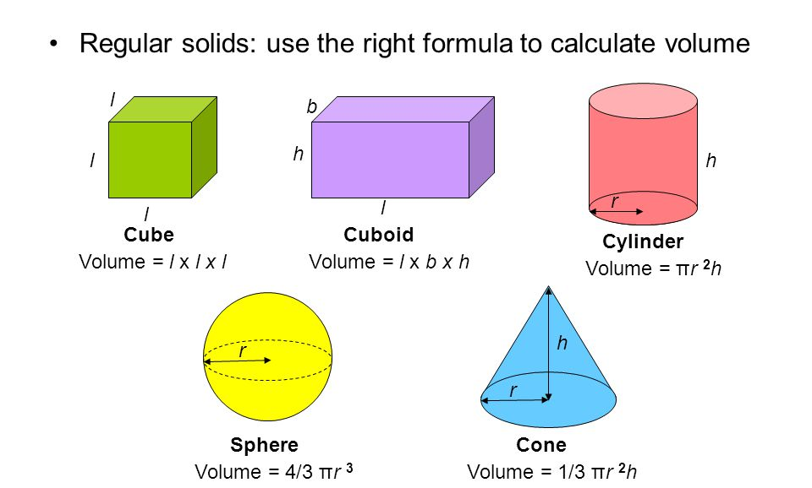

Slide 9
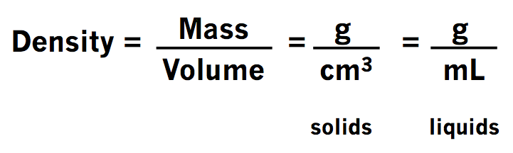
SI Units

Slide 10
Calculating Density
Difficulty Level Easy: https://drive.google.com/file/d/1mmU0rTNV1mU7yOZS8A0hWK2zS184Uj8C/view?usp=sharing
Difficulty Level Challenging: https://drive.google.com/file/d/16uHGs5mjM1X_9ckugqz9_Ly3-XkpQRYw/view?usp=sharing

Slide 11
Calculating Density:
Regular Objects
Irregular Objects
Liquids
Practice Sheet 1
Practice Sheet 2
Practice Sheet 3

Slide 12
Pressure

Slide 13
What hurts more, pinching or poking?
What is more comfortable, sneakers or heels?
Why is it easier to push the sharp edge of the pin into the board, and not the broader base?

Slide 14
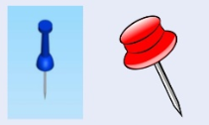
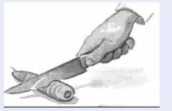
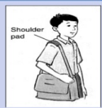
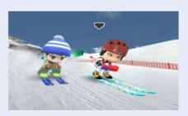
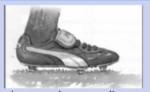

Slide 15
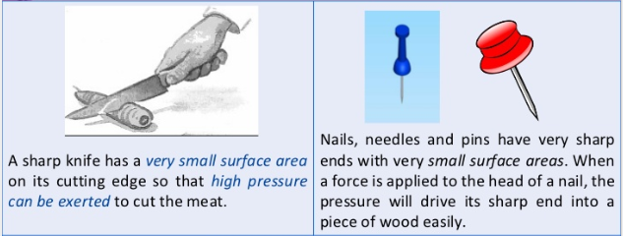

Slide 16
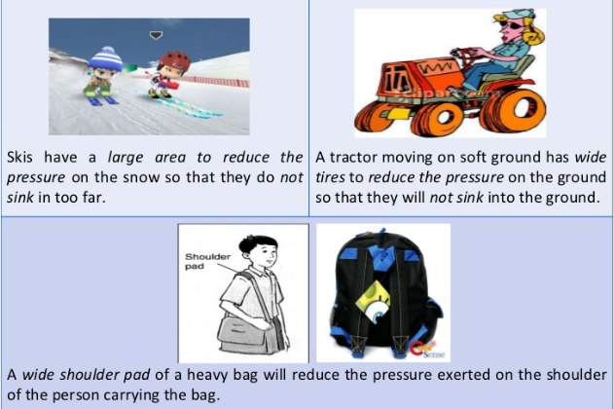

Slide 17
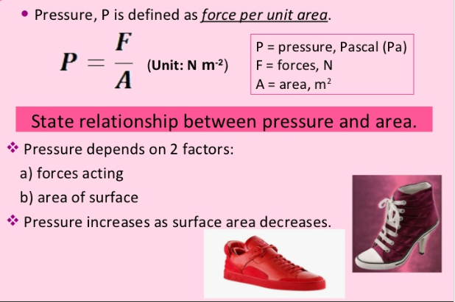

Slide 18
Problems:
A butcher uses a knife with a surface area of 0.2 m^2 to cut a piece of meat. If the butcher uses 20 N of force to cut the meat, what is the pressure produced?
A pressure of 2000 Pa is applied to a floor with an area of 0.2 m^2. What is the force produced?

Slide 19
Practice Problems:
Practice 1
Practice 2
Practice 3
Practice 4
Practice 5
Density Extra Practice 1
Density Extra Practice 2

Slide 20
What are fluids?
Is air a fluid?
Do fluids exert pressure?

Slide 21
Substances that can flow
Includes gases and liquids
Doesn’t have a fixed shape; takes the shape of a container they are poured into

Slide 22
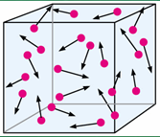
FLUIDS
Fluids exert pressure against surfaces they touch
Molecules constantly moving in all directions and colliding with each other and any surface they meet

Slide 23
FLUID PRESSURE
As each molecule collides with a surface, it exerts a force on the surface.
All of the forces exerted by the individual molecules in a fluid add together to make up the pressure exerted by the fluid.
Fluid pressure is the total force exerted by the fluid divided over the area over which the force is exerted.

Slide 24
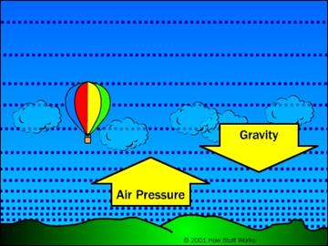
Air Pressure
Pressure exerted by air is called atmospheric pressure;
The air around us contains particles which have mass; they exert pressure on us.

Slide 25
Then, why doesn’t the air pressure crush us?

Slide 26
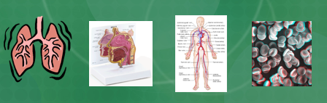
Because, many organs inside our body contain air. The air particles inside our body also exert pressure on the atmosphere, thus creating a balance!

Slide 27
Why are airplanes pressurized?

Slide 28
Why are airplanes pressurized?
Atmospheric pressure decreases as the height of a surface above ground level increases. This is because, as the altitude increases:
the number of air molecules decreases
the weight of the air decreases
there is less air above a surface
This is why aircraft that fly at high altitudes must be pressurised. If the air pressure is too low, humans cannot take in oxygen quickly enough to meet their bodies’ needs.

Slide 29
Investigate the effect of depth on pressure

Slide 30
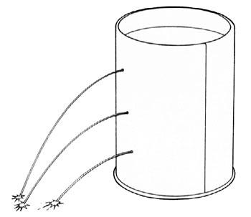
Make three holes at different heights in a plastic bottle; seal the openings and pour water in the bottle. Release the seals. Which of the three holes shoot water the furthest?

Slide 31
Effect of Depth on Pressure
Water, like all things on Earth, is pulled downward by the force of gravity.
Water pressure is the result of the weight of all the water above, pushing down on the water below.
As you go deeper, there is more water above, and therefore a greater weight pushing down.
Thus, pressure increases with depth; same anywhere at a given depth and in every direction.

Slide 32
Floating and Sinking
Find the density of water;
Find any 6 objects and calculate their respective densities; see whether they float or sink in water;
Calculate the specific gravity (ratio of density of object to that of water)
Do you see any patterns with respect to the ratios for objects that float and those that sink?

Slide 33
Buoyancy
Buoyant force applied by a fluid is directed upwards
Force comes from a difference in pressure exerted on top and bottom of the object.
For a floating object, the top surface is at atmospheric pressure is lower, while the bottom surface is at a higher pressure because it is in contact with a fluid at a particular depth
For a submerged object, the top surface is no longer at atmospheric pressure, but the bottom surface is still at higher pressure because it is deeper inside the fluid.
In both cases, the difference in pressure results in a net upward force

