Slide 1
What’s Bugging You?
Mansi Gandhi
MYP 3 (2020-21) Sciences

Slide 2
Are we the only living beings in this room?

Slide 3
Analyse the images on the next few slides. Each slide will be displayed for 5 seconds.

Slide 4
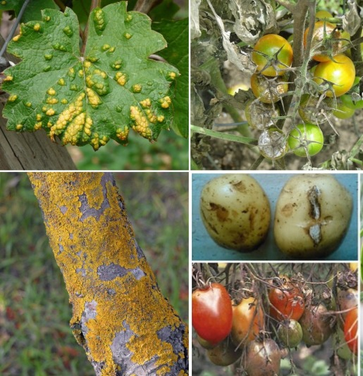
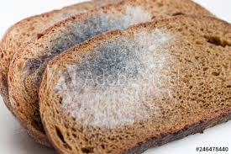
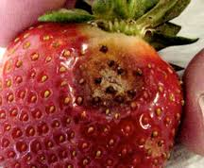

Slide 5
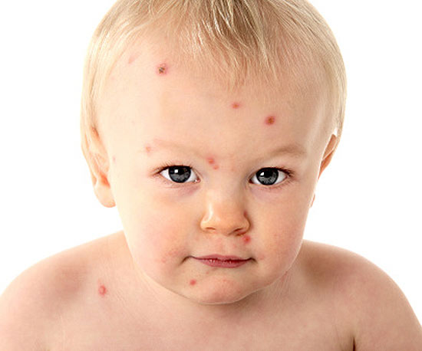
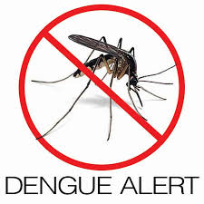
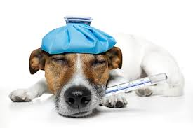
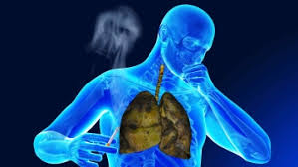

Slide 6
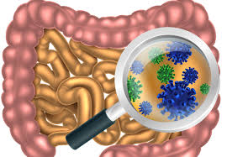
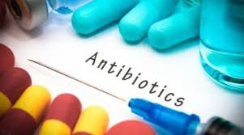
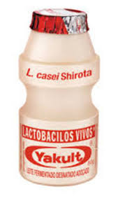
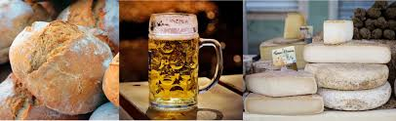

Slide 7
What caused all those changes?

Slide 8
Microorganisms

Slide 9
How would you define a “microorganism” or a “microbe”?
What do you know about microorganisms? Are they all bad?
Do they affect only human beings?

Slide 10
What Do You Know About Microbes?
Living organisms too small to be seen with the naked eye and found everywhere
  Bacteria, virus and fungi
Bacteria can live anywhere, viruses need to live in a host cell
Not always harmful (e.g. cheese, bread, medicines, digestion)
Even harmful microbes can be used for research: certain strains of E. coli and Salmonella can cause severe diarrhoea if ingested in humans (can be used for genetic engineering, vaccination development, etc.)

Slide 11
Microbe Detective
This is a cool experiment to find out where all the microbes are hiding in your home. But remember, not all microbes are harmful, most of the microbes you will find are completely harmless to us. Have fun playing microbe detective!

Slide 12
How can we make this a fair test?
What will we measure/compare at the end of 7 days?

Slide 13
Fair test:
Only one variable changes (surfaces), all other conditions remain the same
Same amount of water, same size of the bread slice, same time duration (7 days)
Compare the mould growth on the bread slices at the end of 7 days.

Slide 14
Take a slice of bread and put into a plastic bag. Label as “control”.
Add a few drops of water to the rest of the bread slices.
Take a slice of bread and rub it on the floor; label the bag “floor”.
Repeat step 3 for 3 different surfaces in your house. Each time seal the bag and label with the surface name.
Place all the bags in a cupboard, and leave them for a 1 week. Take notes/photos of any changes you see to the bread every day. Never open the bags.
Remember to write “Do not eat” on the bags!

Slide 15
Criterion B: Inquiring and Designing
Where do you think you will see the maximum amount of microbes?
Summarize your experiment in this lab report

Slide 16
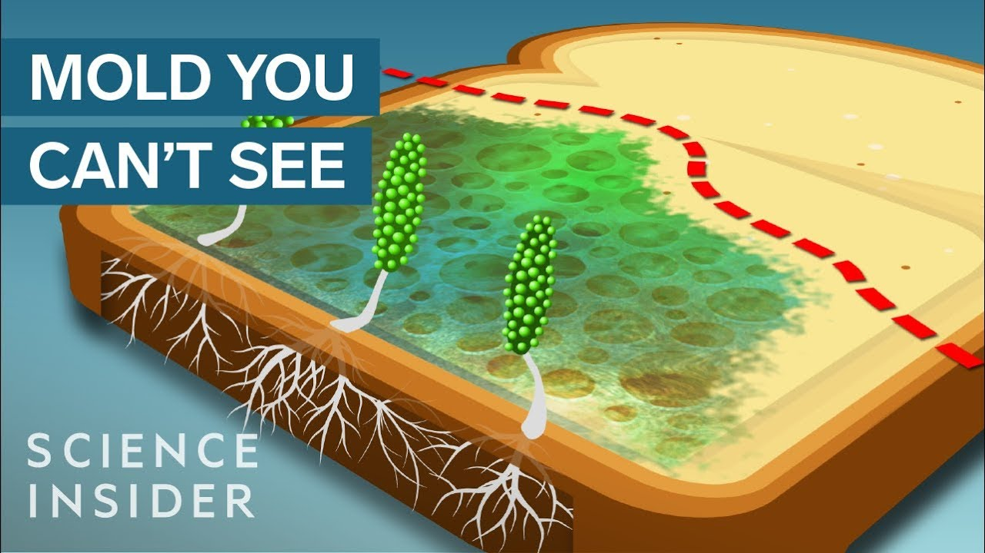

Slide 17
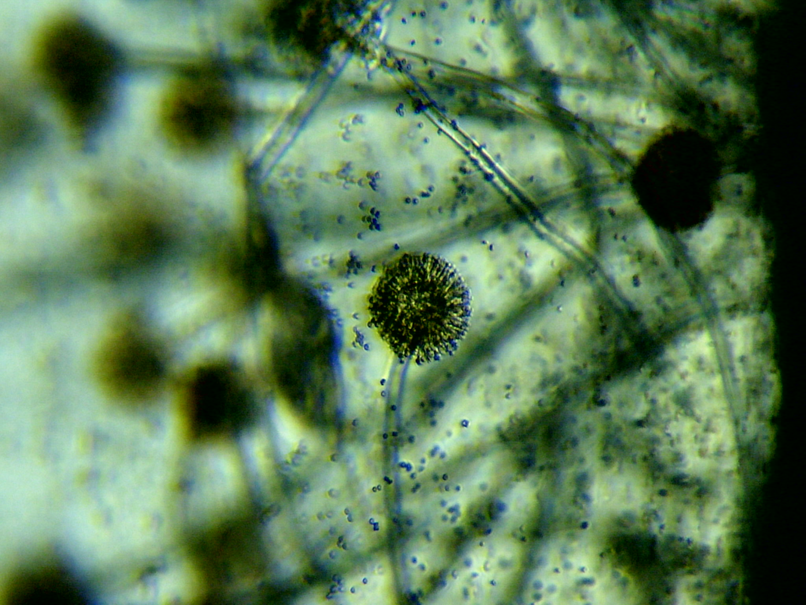
Did the mold grow from the bread?
If not, then where did it come from?

Slide 18
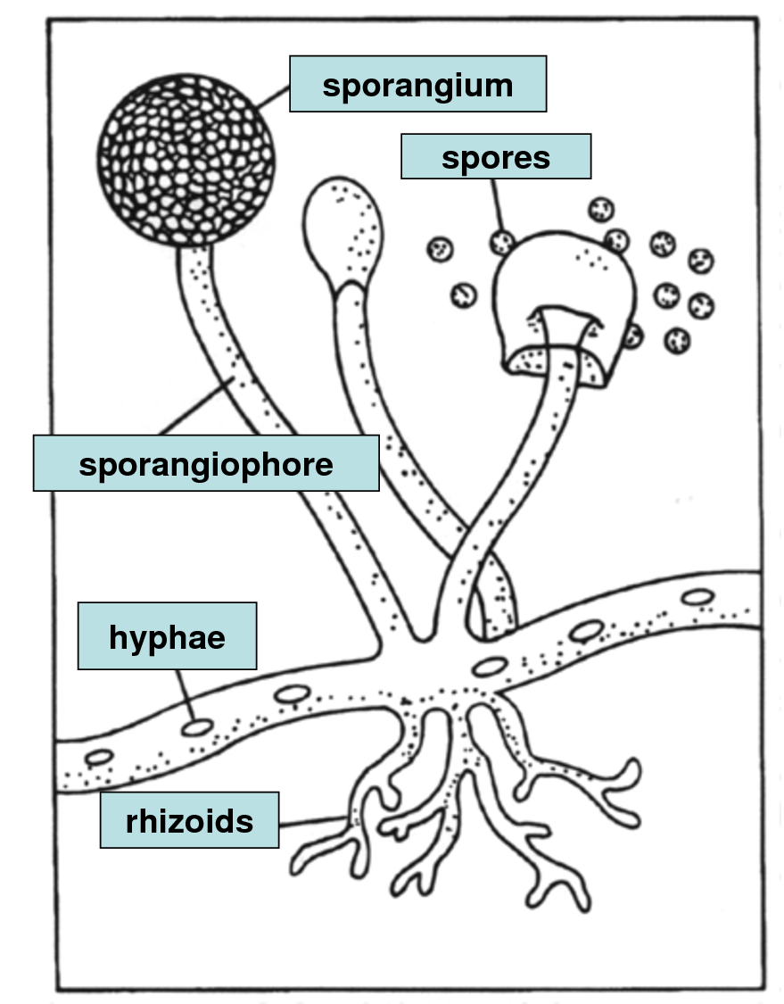
Microscopic (very small) parts of the mold are called SPORES
Spores are present in the air around us and even on different surfaces
When spores come in contact with the bread, they germinate (grow) to form HYPHAE
HYPHAE grow on the bread and absorb all the nutrients
When there is enough nutrition, the hyphae grow into RHIZHOIDS
RHIZOIDS go deep into the bread surface and hold on to it and form SPORANGIUM, where spores grow.

Slide 19
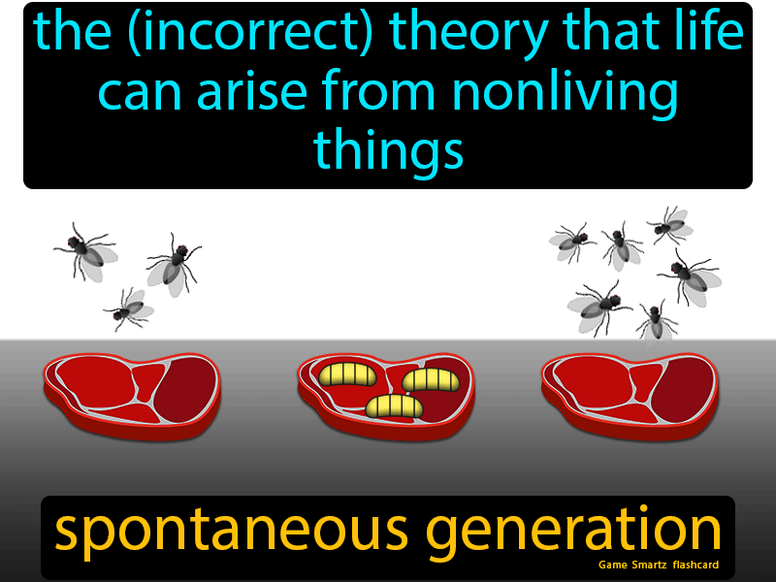
The mold didn’t grow from the bread!

Slide 20
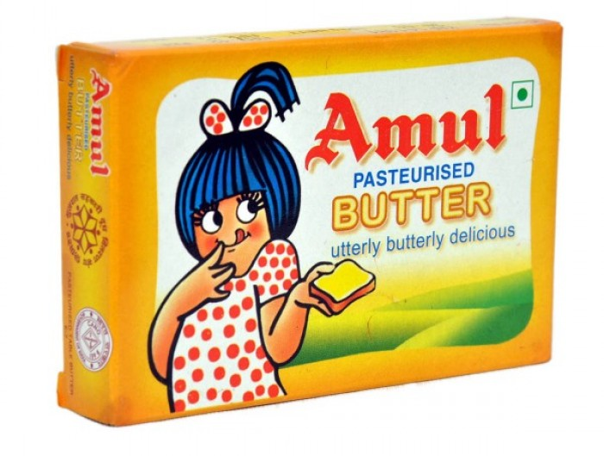
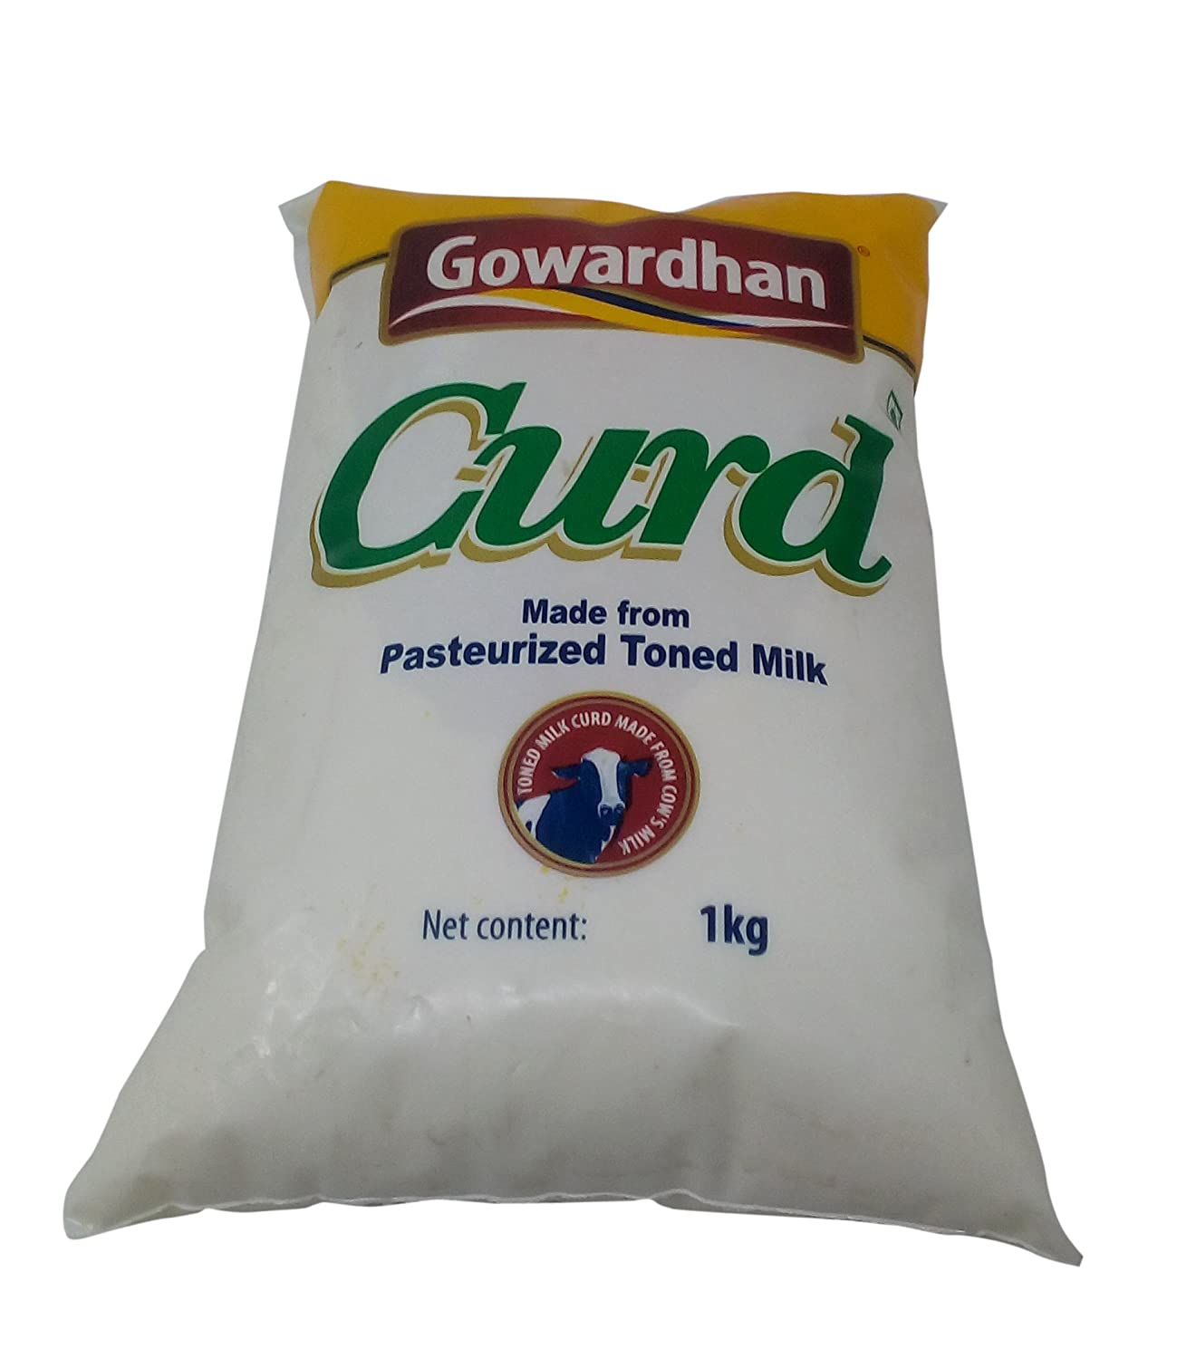
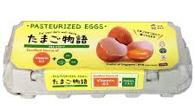

Slide 21
Watch a video on Pasteurization
In your groups, conduct research on Louis Pasteur and create 1-2 slides presenting his discovery:
Who was Louis Pasteur? Add a photo.
Describe the problem that Louis Pasteur identified? How did the scientists solve this problem?
Which technique came to be known as pasteurization?
Which discovery led to the application extended to the dairy industry?
How has Louis Pasteur’s discovery impacted human health and economy?
Cite sources in MLA format
Rubric

Slide 22
View the different types of microbes under the virtual microscope.
Bacteria (singular bacterium)
Viruses (singular virus)
Fungi (singular fungus)

Slide 23
View the different types of microbes under the virtual microscope.
Name of the microbe: | Is it a Bacteria/Virus/Fungus? | How is its shape? | Good Microbe or Bad? | Why is it good/bad? | Where can it be found?
Yersinia pestis | Bacteria | Rod-shaped, slender | Bad | Causes bubonic plague (through infected flies); killed millions of people in an epidemic | Rodents

Slide 24
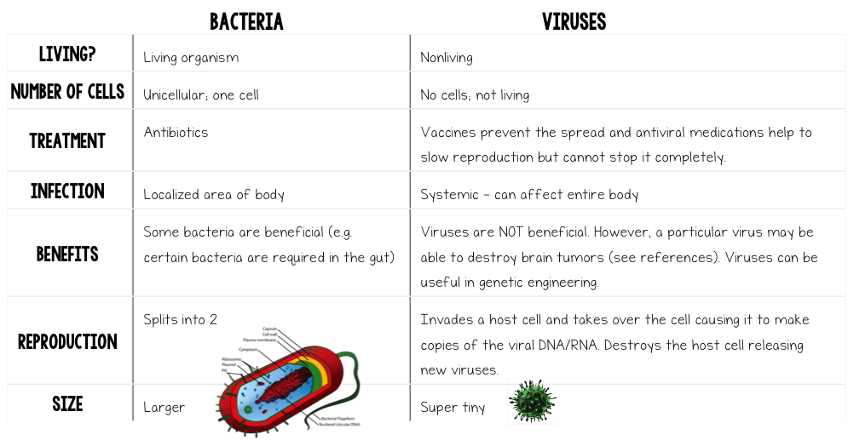

Slide 25
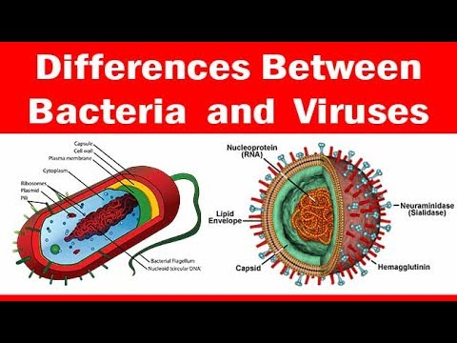

Slide 26
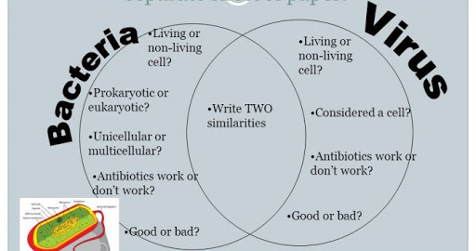

Slide 27
Sort the cards on your table into good and bad microbes. Each group should create a poster the following topic:
Choose one of each type of microbe: bacterium, virus and fungus e.g. Salmonella, Influenza, Penicillium. Make a poster which includes:
Comparison of the structure of the microbes (shape, size, appearance)
The different places they can be found
How they affect humans or plants in either a good or bad way
Any specific growth requirements of that group of microbe
Include a Venn diagram in your poster.

Slide 28

Yogurt Making
List the main steps in yogurt making.
Why is the milk boiled and then cooled down?
Which are the two bacteria in the starter culture?
Why does yogurt have a tangy taste? Name the process which causes this?
What physical changes occur as milk changed to yogurt?

Slide 29
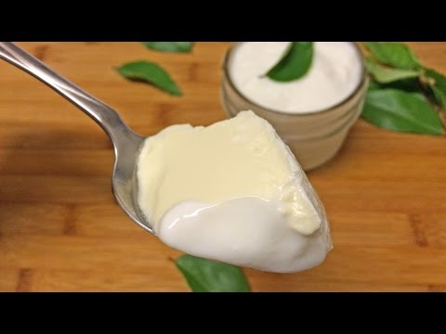
Make Your Own Yogurt!

Slide 30
Body’s Defense System
Read the following information sheet and prepare a one-minute movie in your group enacting the human immune system.
YouTube Video
Defense System Information Sheet
Roles:
Skin, Leukocytes (phagocytes and lymphocytes), Pathogen, antigen, T-cells, B-cells,

Slide 31
Good Microbes: How do Antibiotics Work?
Antibiotic Resistance Lab

Slide 32
Good Microbes: Fermentation Experiment (Criteria B and C Summative Assessment)
https://www.youtube.com/watch?v=FYClCHVT00M
Design an investigation to compare what causes more leavening during baking: baking powder or yeast. Write a lab report summarizing your findings.
Task sheet: Request for access

Slide 33
Diseases and Treatment
What does “disease” mean?
What does “infection” mean?
How do diseases spread?
What are some treatments for diseases?

Slide 34
Disease: an illness characterised by an identifiable group of signs or symptoms.
E.g. rash, fever, cough
Infection: Presence of a microbe in the body
Body’s defence: White blood cells, T-cells, Memory cells, Platelets
Treatments: Vaccines, antibiotics, creams, syrups

Slide 35
Incubation: time between entry of an organism into the body and showing of symptoms
Pathogen: Disease causing microbe (e.g. bacteria, virus, fungus)

Slide 36
Diseases
Why do we see infectious diseases that used to be found in a single region, all over the world today?
Many infectious diseases start in a specific region or country.
Today, however, people travel faster, more frequently and further than ever before
Vector-borne, water-borne, air-borne, food-borne

Slide 37
Analyse the disease data sheet and complete the table.

Slide 38
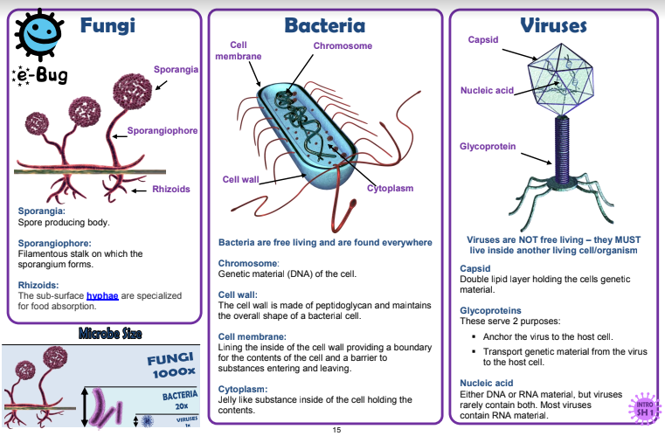

Slide 39
Summary of Diseases and Treatment
What are some disease causing microorganisms?
What are symptoms?
What are some ways in which diseases can be transmitted?
What are some ways in which diseases can be prevented?
What are some ways in which diseases can be treated?

Slide 40
Key Takeaways
Infectious: a.k.a. Transmissible, communicable diseases
(infection begins when a microorganism enters the host cell, GROWS, and multiplies, “X”)
Pathogen: Any organism capable of causing disease (e.g. virus, bacteria, fungi, protozoa)
A microorganism is not considered as a pathogen until it reaches a population size large enough to cause disease

Slide 41
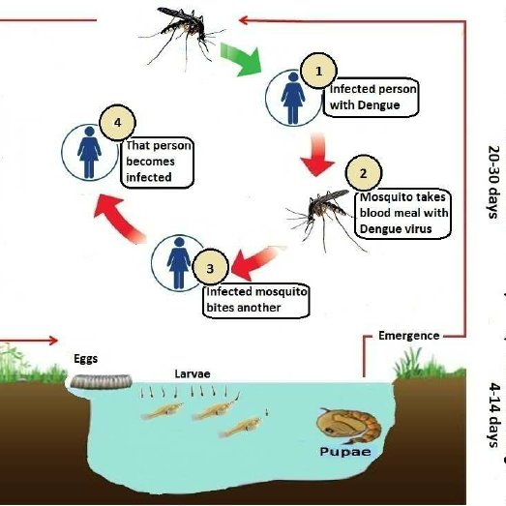
Dengue Life Cycle

Slide 42
Transmission of Microorganisms
droplet contact by coughing or sneezing on another person
Touching an infected person
Touching an infected surface (e.g. soil)
Airborne transmission or vector (e.g.mosquito) borne transmission [e.g. how coronavirus came from bats]
Fecal-oral transmission (contaminated food or water)
Contamination by blood transfusion or organ transplants

Slide 43
Points of Entry in the Body
Respiratory (nose, mouth, eyes)
Skin (open wound or penetration into the skin)
Fecel-oral: mouth
Genital
Saliva and blood (sharing objects: towels, needles, razors, toothbrushes, etc.)

Slide 44
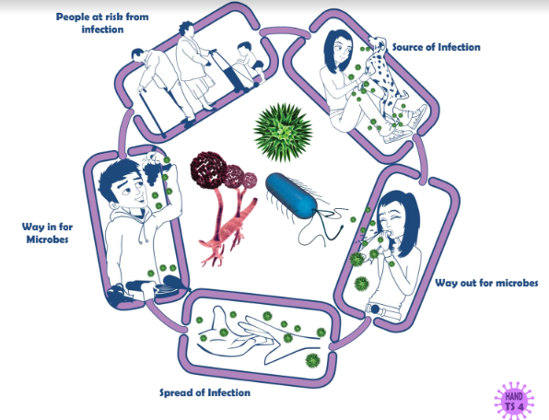

Slide 45
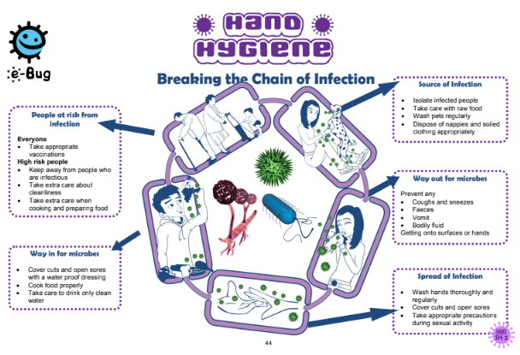

Slide 46
Human Immune System
Vocabulary:
Macrophage
T-cell
B-cell
Antibody
Antigen

Slide 47
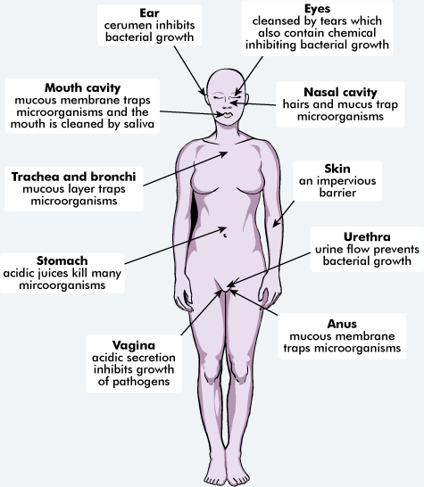
Lines of Defense

Slide 48
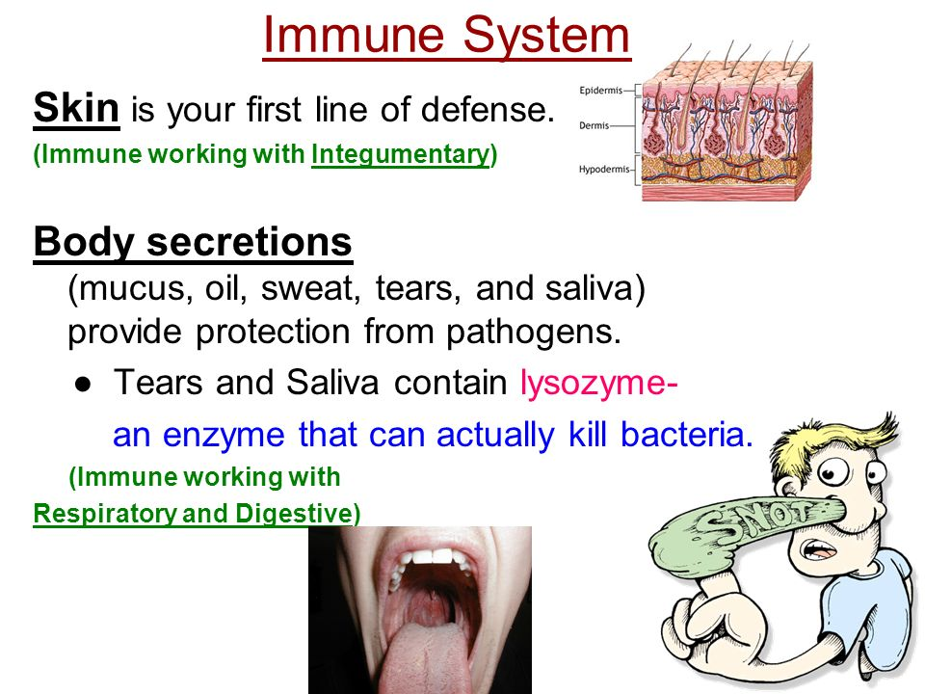
https://slideplayer.com/slide/9467950/

Slide 49
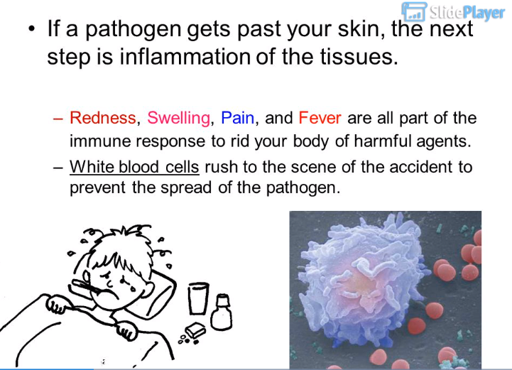
https://slideplayer.com/slide/9467950/

Slide 50
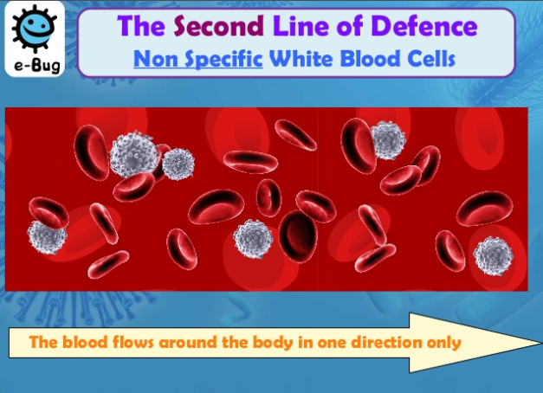
https://pt.slideshare.net/Brodhurst/the-bodys-natural-defences/8

Slide 51
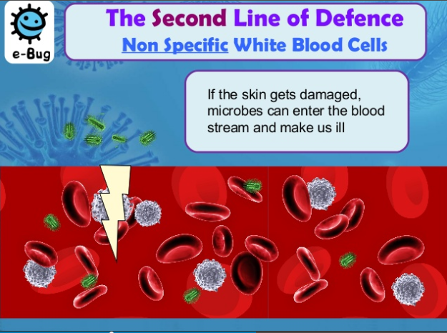
https://pt.slideshare.net/Brodhurst/the-bodys-natural-defences/8

Slide 52
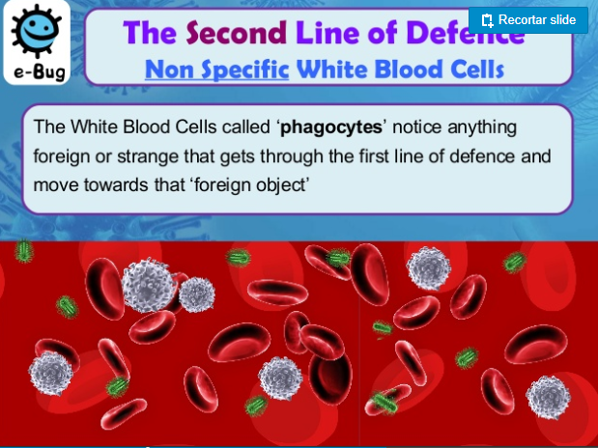
https://pt.slideshare.net/Brodhurst/the-bodys-natural-defences/8

Slide 53
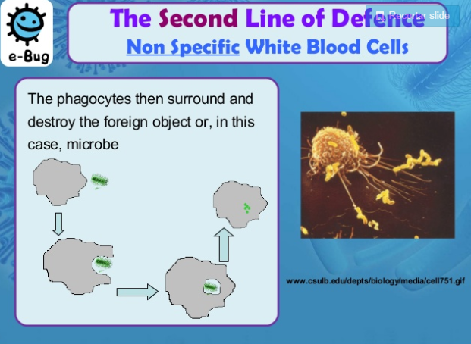
https://pt.slideshare.net/Brodhurst/the-bodys-natural-defences/8

Slide 54
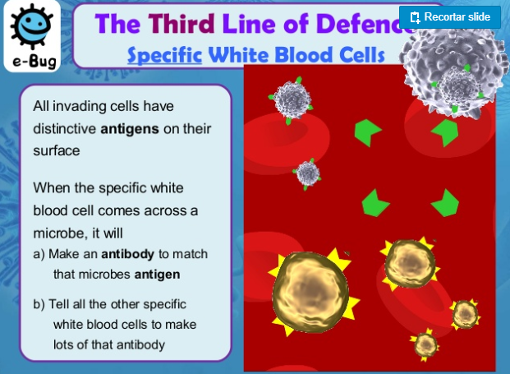
https://pt.slideshare.net/Brodhurst/the-bodys-natural-defences/8

Slide 55
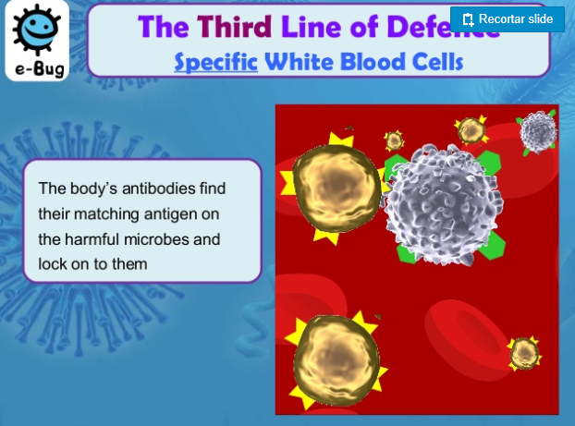
https://pt.slideshare.net/Brodhurst/the-bodys-natural-defences/8

Slide 56
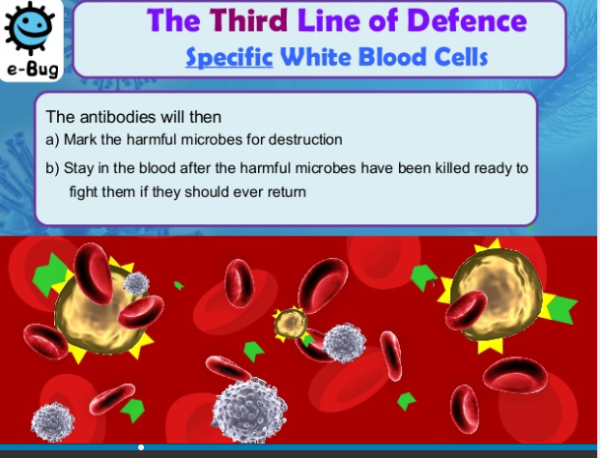
https://pt.slideshare.net/Brodhurst/the-bodys-natural-defences/8

Slide 57
Watch this video on Playposit and answer the questions.

