Slide 1
MYP 3 (2019-20) Sciences: Genetics
Ms. Mansi Gandhi

Slide 2
Think-Pair-Share
Take a look around the classroom. You can see that everyone has a number of different features and characteristics.
  Look at two of your friends and write down three differences between your characteristics than theirs characteristics.
  What do you think is causing these differences?
  What do you think will happen if we didn’t have these differences? How would the world be?

Slide 3
GENETICS IN HARRY POTTER
Credit: https://www.nlm.nih.gov/exhibition/sciencemagicmedicine/pdf/lesson1.pdf

Slide 4
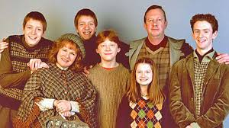
What do the Weasley’s have in Common?

Slide 5
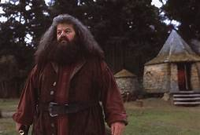
How is Hagrid different from everyone else at Hogwarts?

Slide 6
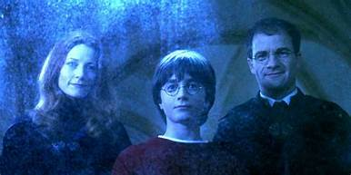
Name one similarity between Harry and his Mother.

Slide 7
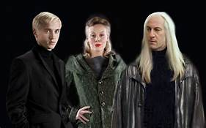
Who do you think Draco Malfoy resembles more, his mother or father?

Slide 8
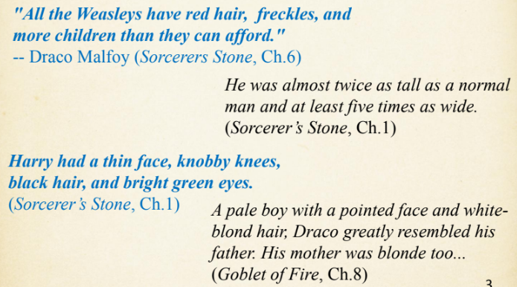

Slide 9
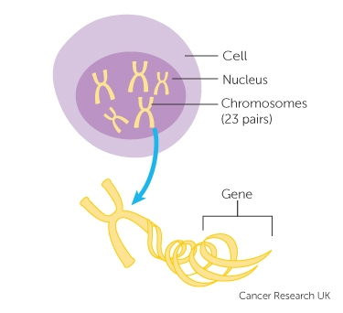

Slide 10
What are these differences and what causes them?
VARIATION: differences between individuals of the same species
GENETICS: Study of genes
INHERITANCE: Passing of traits from one generation to another
Genetic material: Genes, chromosomes, De-oxy-ribo-nucelic acid (DNA) found in the nucleus of a cell

Slide 11
Inherited Variation
Differences due to genes passed on from the parents to the offspring
Living organisms usually look a little like their parents. This is because they get half of their genetic material from each parent.
Each egg cell and each sperm cell contains half of the genetic information needed for an individual. When these join at fertilisation a new cell is formed with all the genetic information needed for an individual.
Examples: eye colour, hair colour, skin colour, lobed or lobeless ears, ability to roll your tongue, red colour of a flower

Slide 12
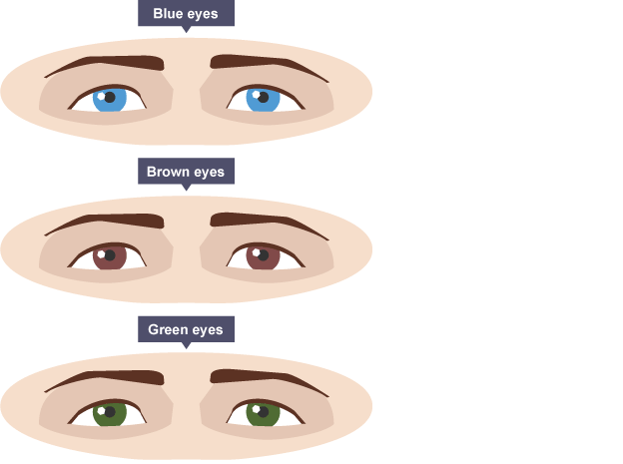
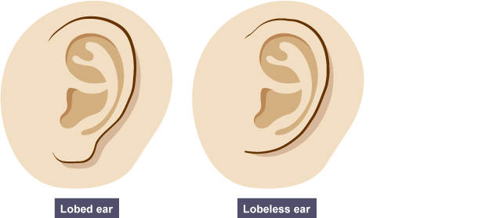
Inherited Variation

Slide 13
Environmental Variation
Characteristics of animal and plant species can be affected by factors such as:
climate
diet
culture
lifestyle
For example, you will become heavier if you eat too much food, and you will become lighter if you eat too little.
A plant in the shade of a big tree will grow taller as it tries to reach more light.

Slide 14
Inherited and Environmental Variation
Some features vary because of a mixture of inherited causes and environmental causes.
Identical twins inherit exactly the same features from their parents. However, if you take a pair of twins, and twin 'A' is given more to eat than twin 'B', twin 'A' is likely to end up heavier.
Weight and height are common examples of characteristics that are influenced by both genetic and environmental factors.

Slide 15
Continuous and Discontinuous Variation
Human height is an example of continuous variation.
It ranges from that of the shortest person in the world to that of the tallest person.
Any height is possible between these values. So it is continuous variation.
Other examples: weight, shoe size

Slide 16
Continuous and Discontinuous Variation
A characteristic of any species with only a limited number of possible values shows discontinuous variation.
Human blood group is an example of discontinuous variation.
In the ABO blood group system, only four blood groups are possible (A, B, AB or O). There are no values in between, so this is discontinuous variation.
Here are some examples: blood group, sex (male or female), eye colour

Slide 17
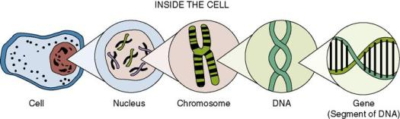
De-oxy-ribo-nucelic-acid

Slide 18
Do You Think Fruits have DNA?
If yes, what would you need to do to reach the DNA and extract it?
果物にはDNAがあると思いますか？
はいの場合、DNAに到達して抽出するために何をする必要がありますか？ （ヒント：植物細胞について考えてください）

Slide 19
DNA Extraction at Home
What do I need to get started?
Fruit (banana, strawberry, kiwi, etc.)
Water
Rubbing alcohol (70% or higher) that is ice cold
Table salt
Plastic bag
Coffee filter
Chopstick, toothpick or paperclip
Clear glasses (or test tubes)

Slide 20
Research Question: Is acetone or mouthwash effective in extracting DNA?
研究質問：アセトンまたはマウスウォッシュはDNA抽出に効果的ですか？

Slide 21
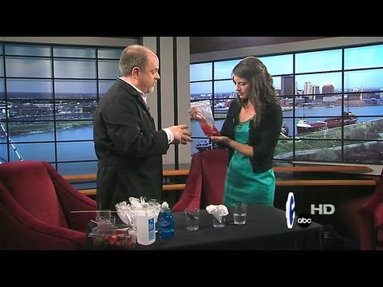
Procedure
https://www.imaginationstationtoledo.org/educator/activities/extract-dna

Slide 22
Procedure
Strawberry DNA Extraction
In a container add 900 mL water, 50 mL dishwashing detergent and 2 teaspoons salt (This is now your extraction buffer)
Put one strawberry and 10 ml of buffer into plastic bag.
Let out as much air as possible from the bag and mash the strawberries
Strain the mixture with the coffee filters and the funnel into a beaker.
Let the mixture settle
Add the cold rubbing alcohol to the strawberry extract slowly, and do not mix
After a few moments the DNA will form cotton like fibers that will spool onto the popsicle stick and it can then be extracted

Slide 23
Procedure
容器に900 mLの水、50 mLの食器用洗剤、および小さじ2杯の塩を追加します（これが抽出バッファーになります）。
いちご1個と緩衝液10mlをビニール袋に入れます。
袋からできるだけ多くの空気を取り除き、イチゴを粉砕します。
ビーカーのコーヒーフィルターに混合物を注ぎます。
イチゴ抽出物に冷たいアルコールをゆっくりと加え、混ぜないでください。
しばらくすると、DNAは綿のような繊維を形成し、丸めてポップスティックスティックで抽出できます。

Slide 24
Procedure
Mash ½ of a peeled banana into a bag with ¼ cup of water
In a cup add 1 teaspoon of the soap, 4 teaspoons of water, and two pinches of salt.
Stir until everything is mixed and the salt is dissolved.
Add 2 teaspoons of the banana mixture to the cup containing the soap solution and stir slowly.
Insert a filter into a clean plastic cup.
Pour the mixture into the filter.
After a couple minutes, some liquid, called the filtrate, should have collected in the bottom of the cup.
Add two teaspoons of rubbing alcohol to another cup then add two teaspoons of banana filtrate to the same cup and wait a few minutes.
Collect the DNA with a popsicle stick.

Slide 25
Procedure
マッシュした皮をむいたバナナを1/4カップの水に入れ、ジップロックバッグに入れます。
小さじ1の石鹸、小さじ4の水、および2ピンチの塩をカップに追加します。
すべてが混ざり、塩が溶けるまでかき混ぜます。
石鹸溶液が入っているカップに小さじ2杯のバナナの混合物を加え、軽くかき混ぜます。
フィルターをきれいなプラスチックカップに挿入します。
フィルターに混合物を注ぎます。
数分後、濾液と呼ばれる液体がカップの底に集まるはずです。
別のコップに小さじ2杯の消毒用アルコールを加え、同じカップに小さじ2杯のバナナ濾液を加え、数分待ちます。
ポプシクルスティックでDNAを収集します。

Slide 26
Debrief:
https://docs.google.com/document/d/1Zd5jgQ9Dh3Hnf60lsl1ZRlfOB_8wfJs-SoXLfhVW9mM/edit?usp=sharing

Slide 27
Questions
Why did we choose to use fruits like strawberries and bananas? What would it be like if we used other fruits and vegetables? Would the experiment/extraction still work?
What is DNA, where is it found, and what does it do?
What was the purpose of mashing up the strawberry?
What was the purpose of adding soap?
  Extension question: Why are we being advised washing our hands to prevent contracting the Coronavirus?
What does the filter do?
What happened when you added the alcohol?
What did the DNA look like?
Is DNA found in all living or once living organisms?
Remember that genes are found on chromosomes, and genes control traits. Give at least two examples of traits that are expressed in the strawberry.

Slide 28
Questions
Results would be the same as all living (or once living) things have DNA. Strawberries and bananas have more copies of the chromosomes.
Deoxyribonucleic acid (genetic material contained in the nucleus, it gives characteristics to the organism)
Breaking the cell wall
To dissolve fats in the cell membrane (cell membrane contains lipids and proteins)
  It is enclosed in a fatty layer, so soap helps to break this envelope
Helps separating the seeds, skin, etc. from the rest of the plant
Proteins don’t dissolve in alcohol, so the protein part of the cell membrane stays separate;
white , threadlike
yes
Shape, color, size

Slide 29
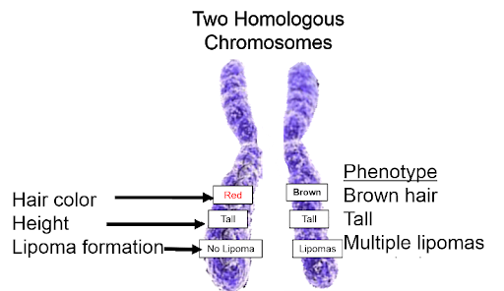

Slide 30
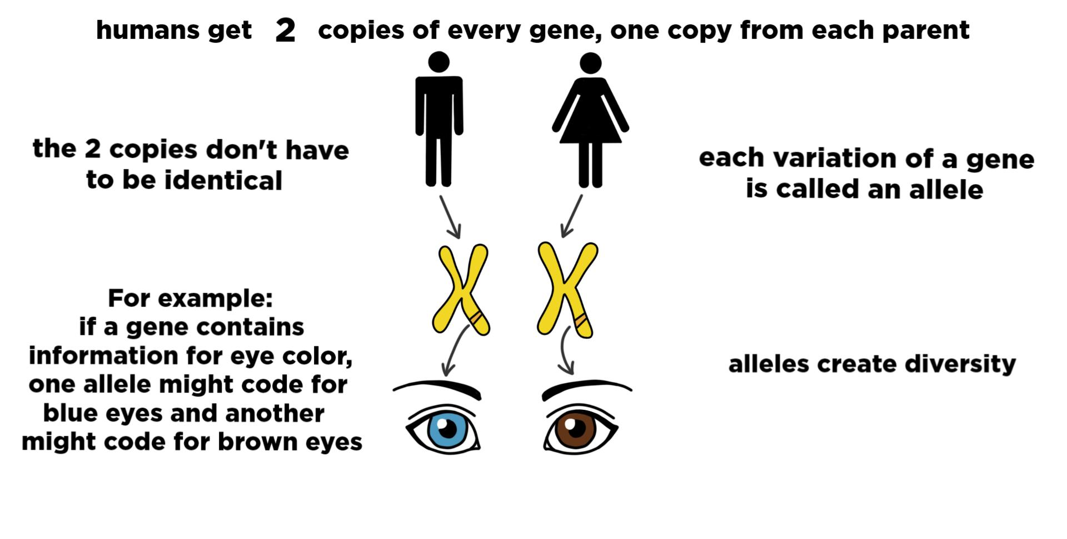

Slide 31
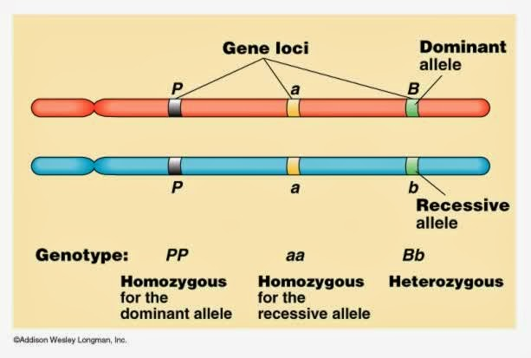
Black eyes
(black hair color)
(short height)
Green eyes

Slide 32
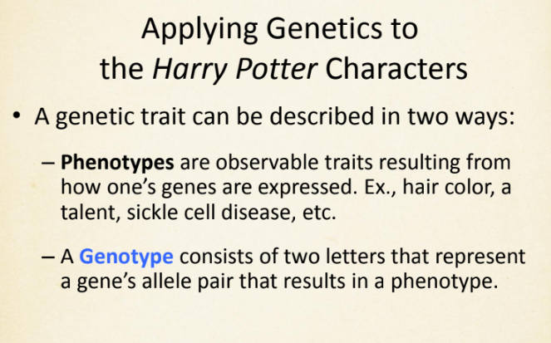

Slide 33
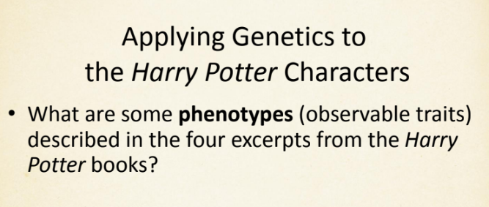

Slide 34
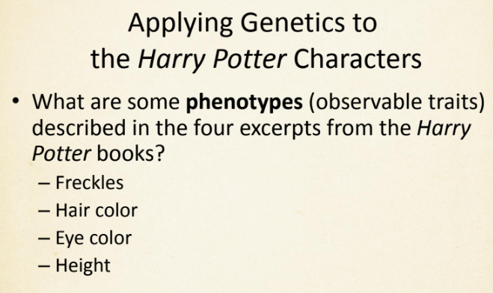

Slide 35
Phenotypes: Freckles Example
Two possible phenotypes for freckles are:
  Has Freckles (observable)
  No freckles (observable)
The possible alleles (forms of a gene) using the first letter of the trait “f” are:
  F (dominant) = Has Freckles
  f (recessive) = No freckles
Question: Using F and f, what are possible genotypes of the allele pair for freckles?

Slide 36
Phenotypes: Freckles Example
Two possible phenotypes for freckles are:
  Has Freckles (observable)
  No freckles (observable)
The possible alleles (forms of a gene) using the first letter of the trait “f” are:
  F (dominant) = Has Freckles
  f (recessive) = No freckles
Question: Using F and f, what are possible genotypes of the allele pair for freckles? FF, Ff, ff

Slide 37
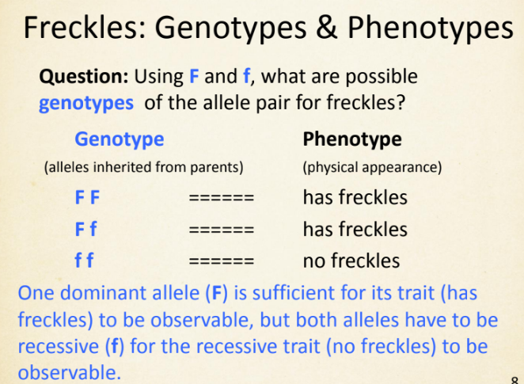

Slide 38
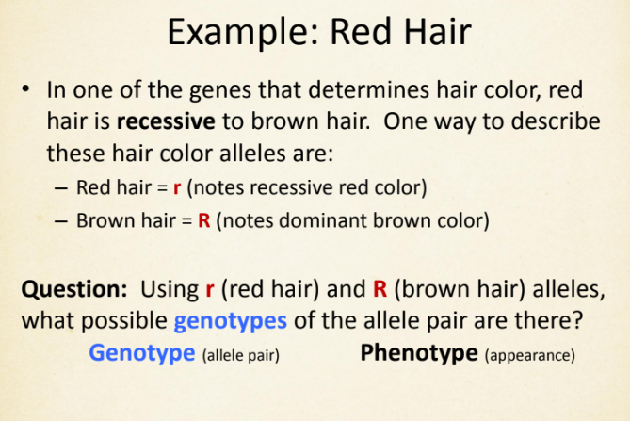

Slide 39
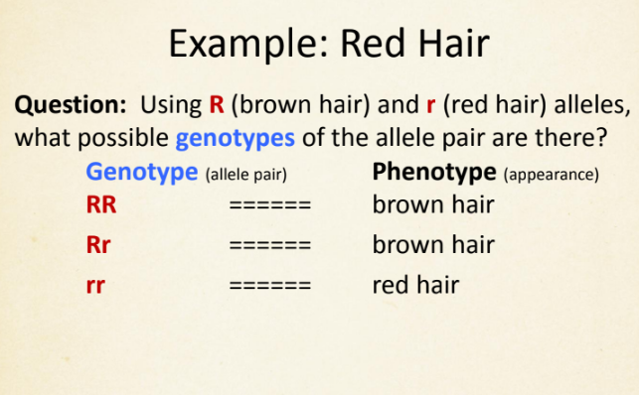

Slide 40
Summarizing Alleles
each organism inherits one allele for a gene from each parent.
combination of genes the organism has is called genotype
If the organism inherits two of the same gene, the genotype is homozygous. If it inherits two different genes, it is heterozygous.
According to Mendel, one of these will be dominant and will be expressed if it is present. It can mask the recessive trait.
An organism can only express a recessive trait if It possesses two recessive traits
When recording genotype, two letters are used, a capital letter (D) for the dominant trait and a lower case (d) letter for a recessive.
By knowing the genotype of an organism, you can identify its phenotype, how it looks.

Slide 41
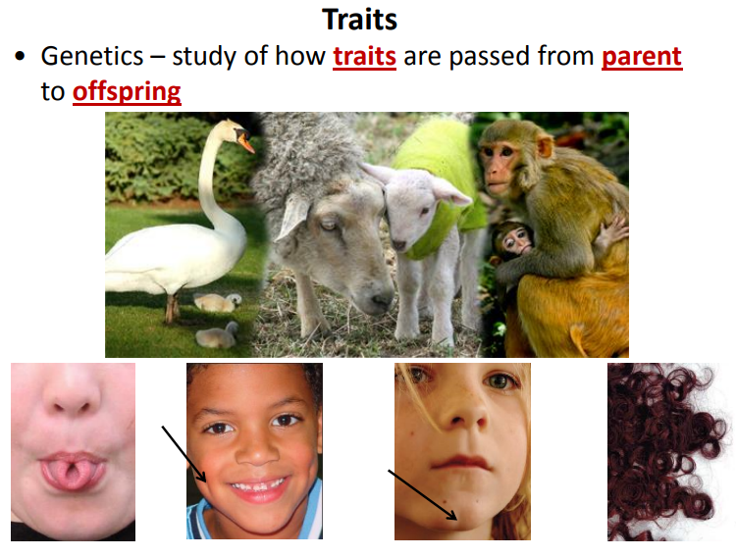

Slide 42
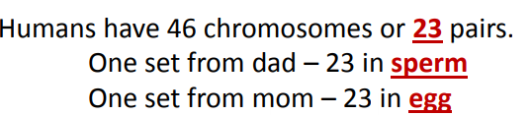
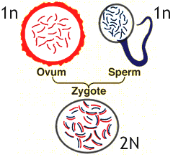
Haploid
Haploid
Diploid
Haploid

Slide 43
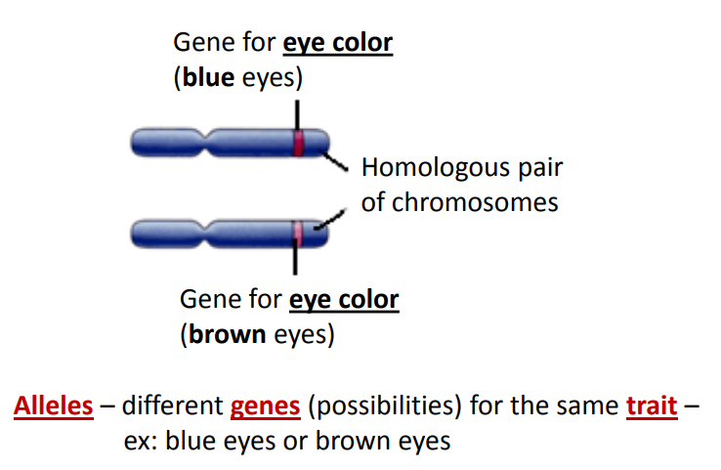

Slide 44
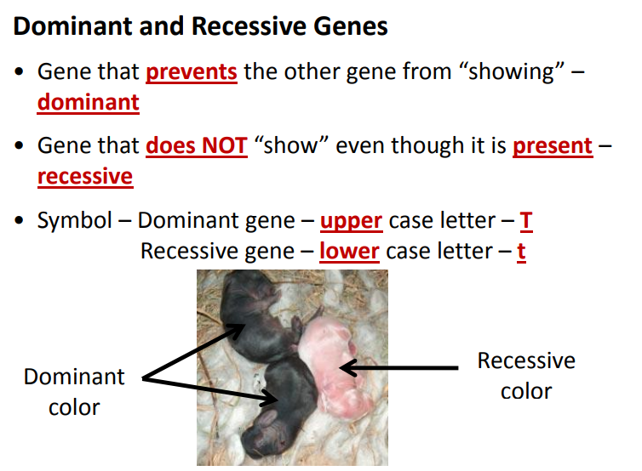

Slide 45
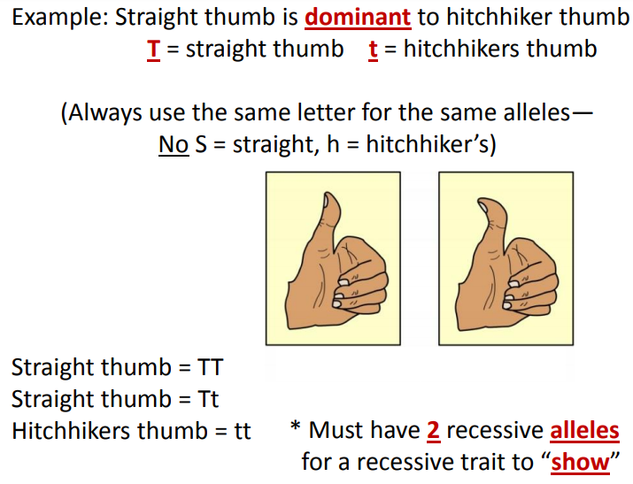

Slide 46
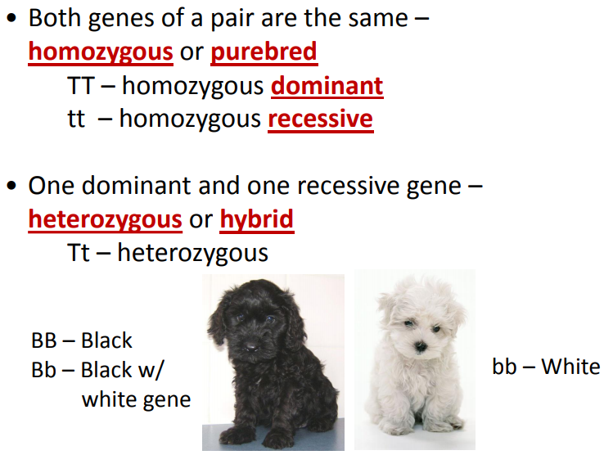

Slide 47
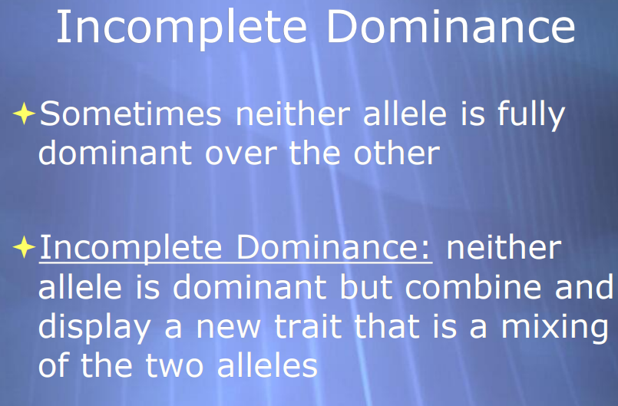

Slide 48
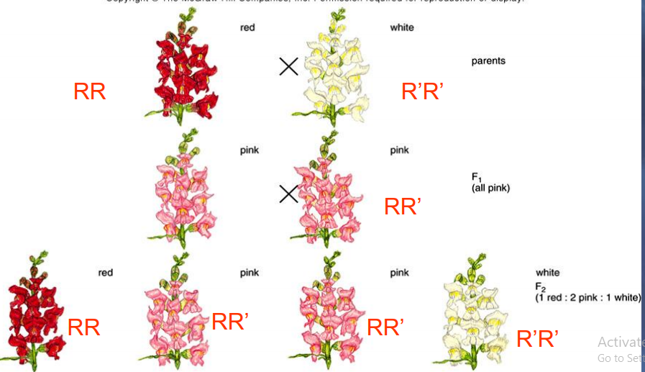

Slide 49
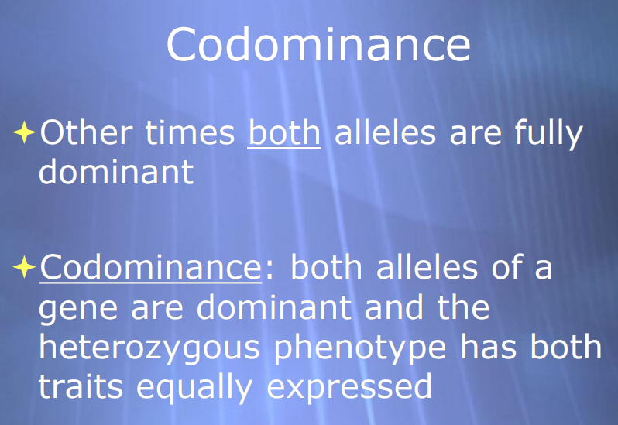

Slide 50
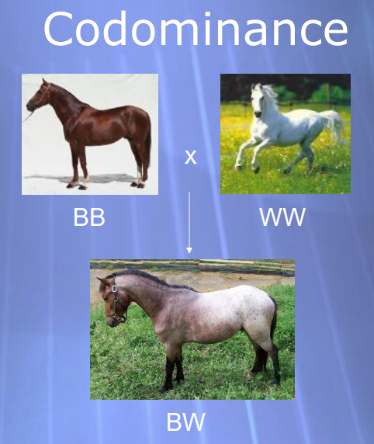

Slide 51
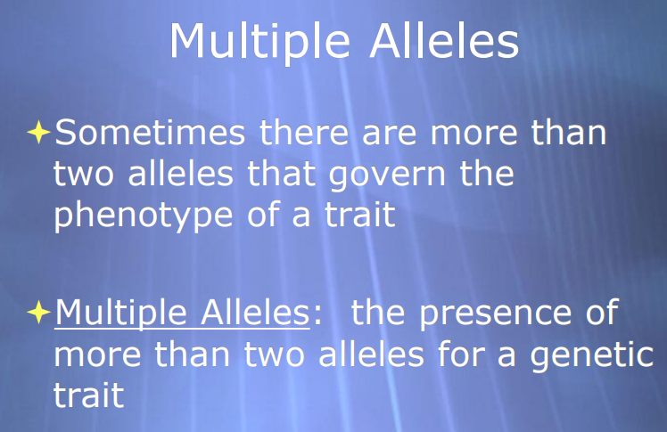

Slide 52
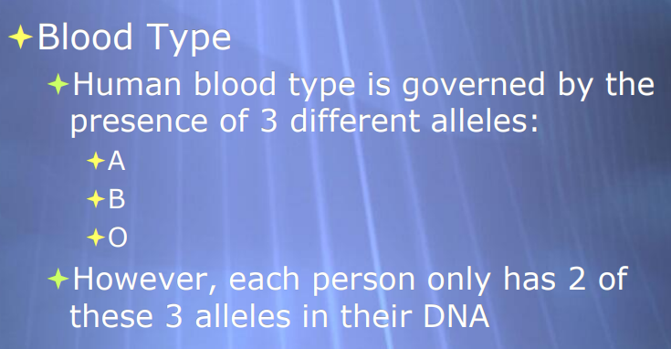

Slide 53
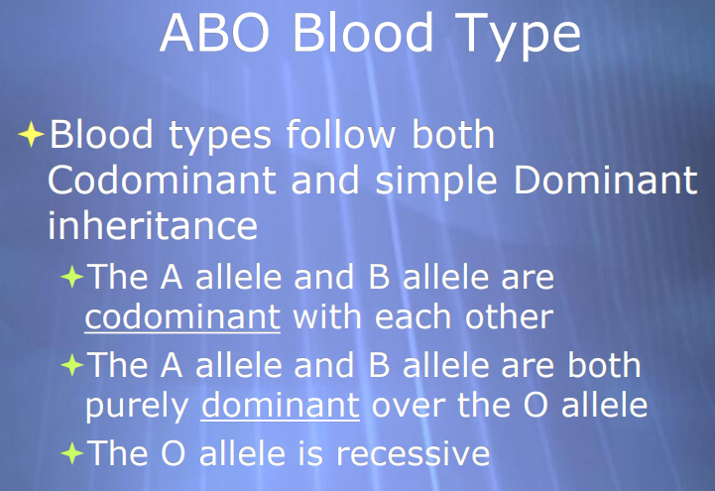

Slide 54
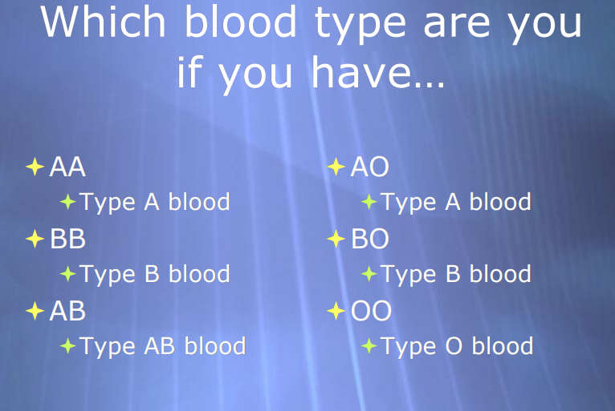

Slide 55
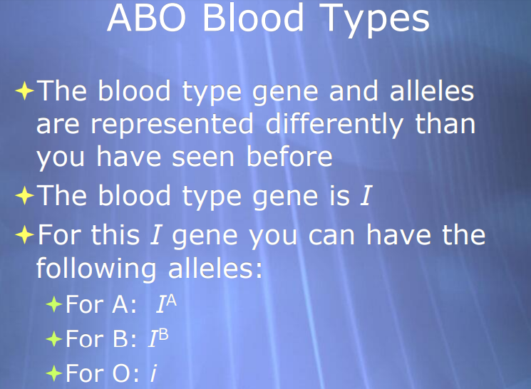

Slide 56
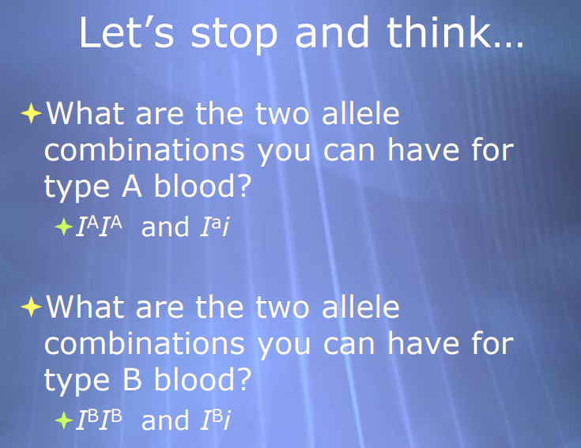

Slide 57
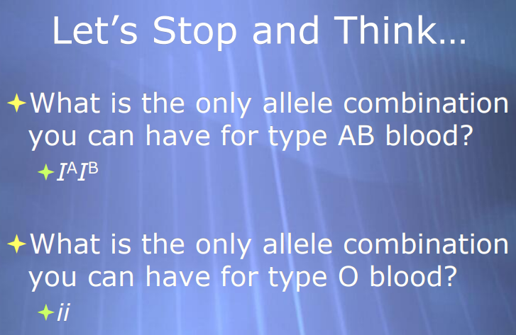

Slide 58
Genotypes and Phenotypes Worksheet: https://drive.google.com/open?id=1Aiu2GAv-ptuurxE2fwHKwKHO-RWFFnzm
https://docs.google.com/document/d/1xSH0A580TbCciM6_vaVheI8SP18-vPDVf3xWNwjv2JM/edit?usp=sharing

Slide 59
Punnett Squares: Make your own Monster
https://www.youtube.com/watch?v=PyP_5EgQBmE
http://www.glencoe.com/sites/common_assets/science/virtual_labs/E09/E09.html
https://docs.google.com/document/d/1v_E-QblD6a0fY_3zpSukwm7yv-lSF8BFsPkpgnIAtoI/edit?usp=sharing
Pigeonetics: https://learn.genetics.utah.edu/content/pigeons/pigeonetics/
https://docs.google.com/document/d/1MvSE3CVUqOM5ribJppLlg91uET8RIFMxKdbvI2jUlxY/edit?usp=sharing
https://docs.google.com/document/d/12Cu4nLPqq6Ly_1hMNzVnmQv0XtuLgU8_DPV1nbVlbms/edit?usp=sharing
https://www.methacton.org/cms/lib/PA01000176/Centricity/Domain/350/Monohybrid%20Cross%20Worksheet%20-%20Key.pdf

Slide 60
Punnett Squares
https://drive.google.com/file/d/1iH6s4gtTsZYG4G6wK3xQgKn5ApD-DH69/view?usp=sharing

