Slide 1
MYP 3 2019-20
Unit 2: Electricity and Magnetism

Slide 2
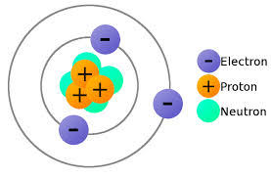
Recap: Atoms
Atoms are small particles that make up all matter.
Inside the atom are even smaller objects called electrons, protons, and neutrons. Electrons have a negative charge (-) and the protons have a positive charge (+).
The protons and neutrons stick to together in the center of the atom, called the nucleus.
The positive charge of the protons keeps the electrons from flying off and leaving the atom.

Slide 3
What is Electricity?
In some elements, there are electrons on the outside of the atom that, when a force is applied, can come loose and move to another atom.
When a bunch of atoms are together and electrons are moving from one atom to the other in the same direction, this is called electricity. Electricity is the "flow" of electrons.
We make electricity by creating an electric circuit.
  Power source: Could be a battery or your wall outlet
  Conductor: The wires that carry the electricity from place to place
  Load: what the electricity is powering, like the light bulb in the example above
  Switch: The switch that connects the circuit together to start the electricity flowing
Energy is converted from one form to another in the circuit: e.g. chemical energy from a cell is converted into electrical energy, electrical energy is further converted into heat/light/sound energy, etc.

Slide 4
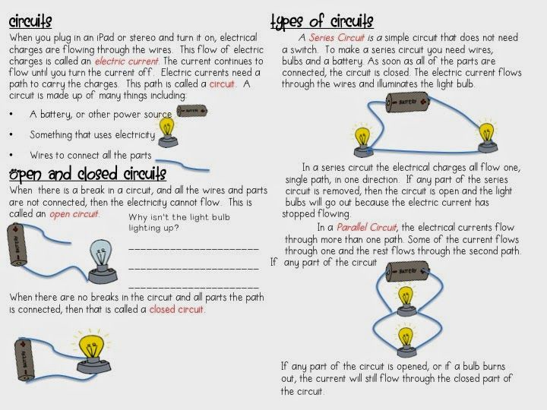

Slide 5
Building Circuits
https://drive.google.com/open?id=1mAB3eq8f0zZcJwzTvkmNc8KTqlP_c0vS

Slide 6
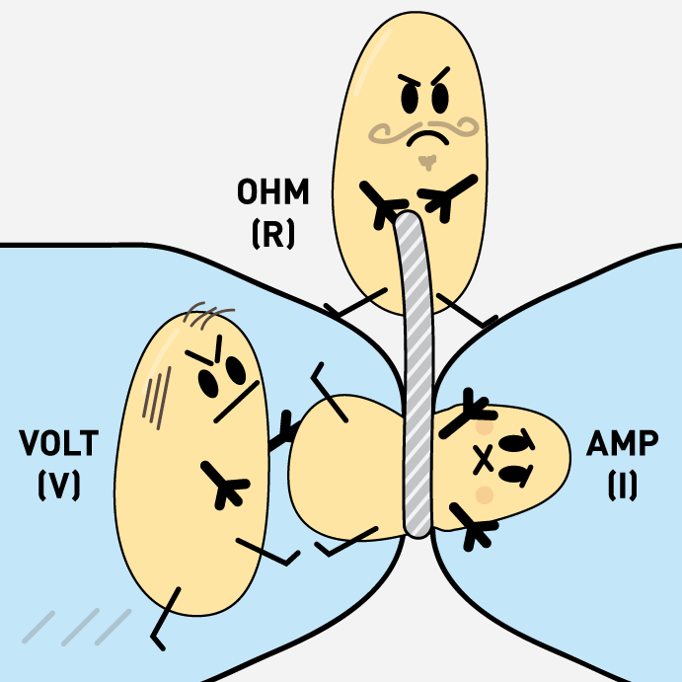

Slide 7
Ohm’s Law
https://drive.google.com/open?id=1qGiE6NHujmJualoVZJU7EV3TXej7JUEF

Slide 8
Online Lab on Ohm’s Law
Investigate the relationship between Voltage, Resistance, and Current
https://phet.colorado.edu/sims/html/ohms-law/latest/ohms-law_en.html
What is the relationship between Voltage and Current?
 | Voltage (Volts) | Resistance (Ohms) | Current (Ampere)
1 | 1.5 | 500
2 | 3.0 | 500
3 | 4.5 | 500
4 | 6.0 | 500
5 | 7.5 | 500

Slide 9
Online Lab on Ohm’s Law
Repeat the above exercise to determine the relationship between resistance and current. Think about the control variable in this case. https://phet.colorado.edu/sims/html/ohms-law/latest/ohms-law_en.html
What is the relationship between Resistance and Current?
 | Voltage (Volts) | Resistance (Ohms) | Current (Ampere)
1
2
3
4
5

Slide 10
Types of Circuits
Compare the following in a series circuit and a parallel circuit:
Voltage
Brightness
Current
https://phet.colorado.edu/sims/html/circuit-construction-kit-dc/latest/circuit-construction-kit-dc_en.html

Slide 11
Extension
Investigate the effect of voltage and resistance on current in each of the following cases:
Series circuit
Parallel circuit

Slide 12
Exploring Magnetism
What is magnetism? Do you know what causes it?
What are some properties of magnets?
  What happens if you break a magnet into two pieces?
  What happens if you heat a magnet?
What kind of objects do magnets attract? Are they made of similar material?
Do you know of any natural magnets?
What happens when a compass is suspended freely? Why?

Slide 13
Exploring Magnetism
What is magnetism? Do you know what causes it?
Magnetism is a force exerted when two magnets attract or repel each other. It is caused by motion of electric charges. Electrons in atoms of Iron, Nickel, and Cobalt spin in the same direction, creating a strong force.
What are some properties of magnets?
  What happens if you break a magnet into two pieces? It creates two smaller magnets (each has a south and north pole)
  What happens if you heat a magnet? Magnetic becomes weaker
What kind of objects do magnets attract? Are they made of similar material? Iron, Cobalt, Nickel

Slide 14
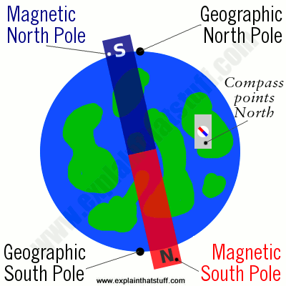
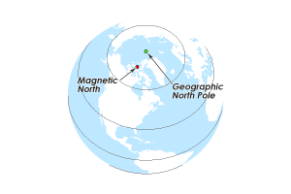
Exploring Magnetism
Do you know of any natural magnets? The Earth’s core contains molten iron which produces an electric current as it flows. As a result a magnetic field is created around it. The Earth’s magnetic north and geographical north are not the same. A magnetic needle in a compass aligns itself with the magnetic poles.

Slide 15
Exploring Magnetism
Place a magnet on a sheet of paper
Tap the iron filings until they form a pattern. Draw the pattern formed.
Where do most of the filings stick to the magnet?
Place two magnets next to each other and repeat the above step. What do you notice this time?

Slide 16
Exploring Magnetism
The lines indicate a magnetic field within which a magnetic force acts
It is strongest near the poles and becomes weaker as the distance from the poles is increased

Slide 17
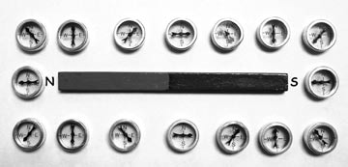
Plotting Magnetic Field Lines
https://youtu.be/DMO373nDp8M

Slide 18
Creating a New Magnet
Temporary Magnet:
Stroke a metallic object against a bar magnet
Electromagnetism
  Factors affecting strength of an electromagnet (number of turns, length of the wire)

