Slide 1
Just Pollen’ Your Leg
Mansi Gandhi
August 2020

Slide 2
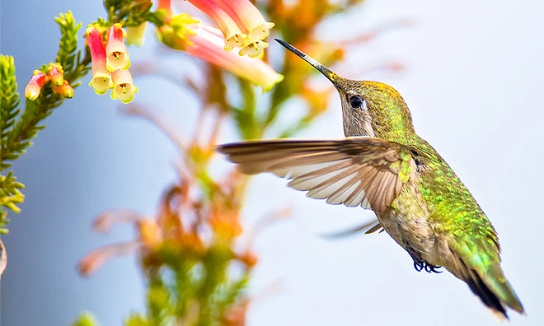
https://ucanr.edu/sites/PollenNation/Meet_The_Pollinators/Birds_/

Slide 3

01. SEXUAL VS. ASEXUAL REPRODUCTION
02. PARTS OF A FLOWER
03. POLLINATION
04. POLLINATORS
Differences, advantages, disadvantages
Male and female reproductive organs
Self-pollination and cross-pollination
Animals, insects, water

Slide 4
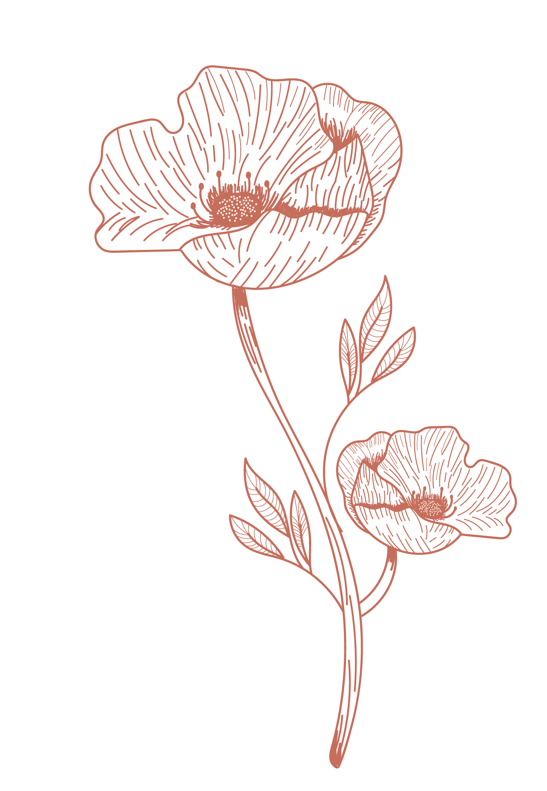
REPRODUCTION
Biological process in which new individual organisms or “offspring” are produced from their “parents”.
In this unit, we will learn about reproduction in flowering plants.

Slide 5
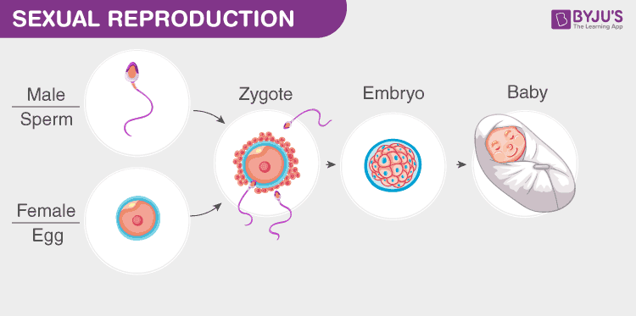
RECALL SEXUAL REPRODUCTION
Two parents (male and female)
Male gamete (sperm cell) and female gamete (egg cell) combine to form a zygote > embryo > baby
Offspring characteristics are a combination of the mother and father
Genetic variation

Slide 6
Is sexual reproduction possible only after sexual intercourse?
Take a moment to think.

Slide 7
How do you thinks plants reproduce, sexually or asexually?
Let’s find out the difference between the two, first!

Slide 8
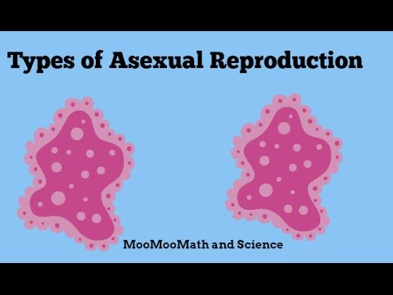
Watch a video on Playposit and answer the questions.
ASEXUAL REPRODUCTION
https://app.playpos.it/go/play/820734/1420456/929077/0/Asexual-Reproduction

Slide 9
Only one parent is involved.
Offspring are genetically identical to their parents.
No gametes are involved.
Quick.
Little variation.
ASEXUAL REPRODUCTION
1

Slide 10
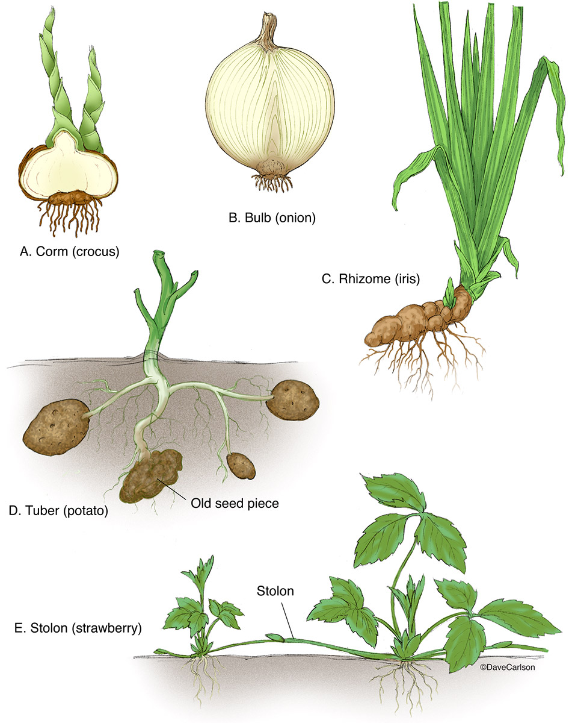
Observe the plants you have brought to class today. Match them with the diagram.
https://www.carlsonstockart.com/photo/specialized-stems-corm-bulb-rhizome-tuber-stolon/

Slide 11
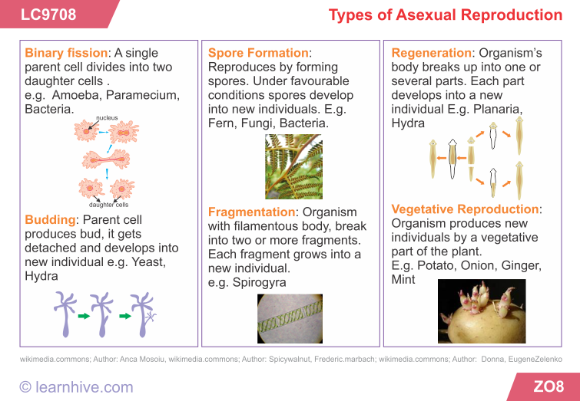

Slide 12
Practice: Asexual Reproduction
https://drive.google.com/file/d/1ojjnkKUDgCVeUsm0G-4Mdsr4rSXc87Oq/view?usp=sharing

Slide 13
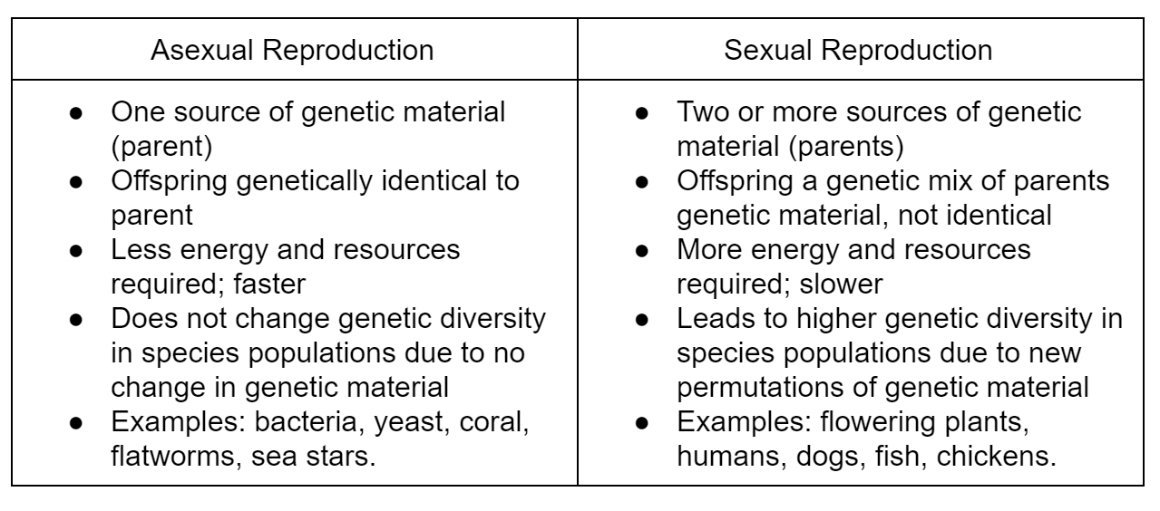
Difference between sexual and asexual reproduction
https://www.expii.com/t/reproduce-asexual-and-sexual-characteristics-of-life-10030

Slide 14
Sexual Reproduction in Plants: Vocabulary
Male
General
Female
Pollen
Anther
Filament
Angiosperms
Fertilization
Style
Stigma
Ovary
Ovules
Pollen Tube

Slide 15
Sexual Reproduction in Angiosperms

Slide 16
Sexual Reproduction in Plants: Vocabulary
SEPAL | PETAL | STEM
LEAF | FILAMENT | ANTHER
STYLE | STIGMA | OVARY

Slide 17
Dissecting a Flower
Watch the video on dissection of a flower
Follow the steps in the video and dissect your flower
Paste each part in the correct box on your page, with a tape
State the function of that part in the same box.
If you don’t have a flower, draw the parts, looking at what you see in the video.

Slide 18
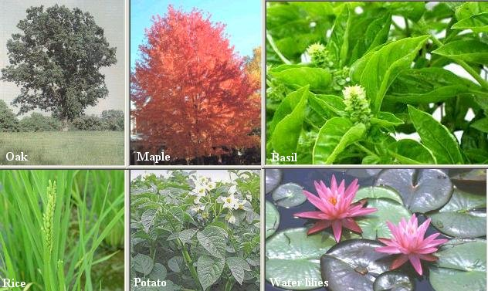
What are angiosperms?
Angiosperms are flowering, seed bearing plants
They produce seeds contained in fruits.
The fruit grows from the parts of the reproductive structure.
Examples: Cherry, Apple, Rose, Broccoli, Rice, Wheat, Water Lily

Slide 19
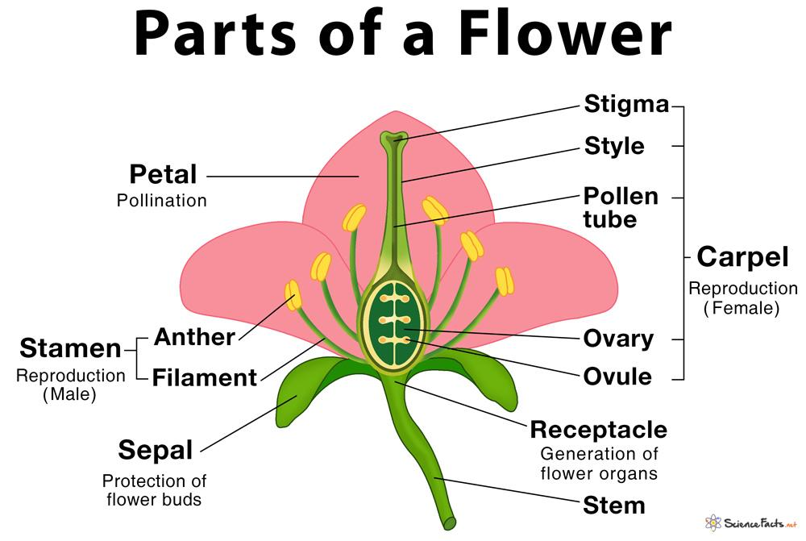
Parts of a Perfect flower
Pistil

Slide 20
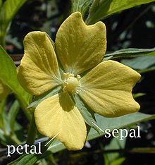
Examining Hibiscus
Pistil
https://en.wikipedia.org/wiki/Sepal

Slide 21
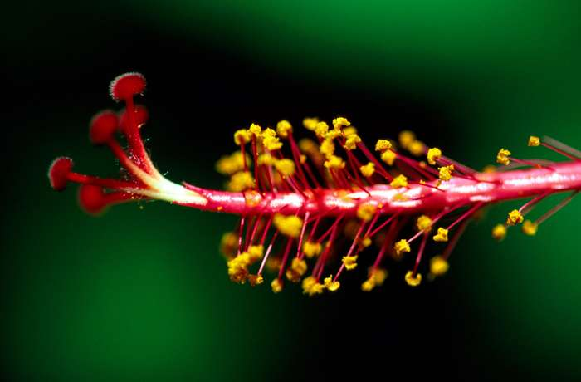
Examining Hibiscus
Stamen ( Male Parts)
Pistil
https://www.britannica.com/science/stamen

Slide 22
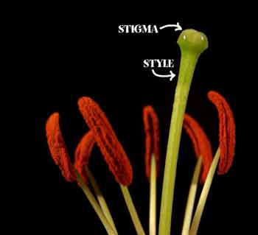
Examining Hibiscus
( Female Parts)
Pistil
https://kidsgrowingstrong.org/about-flowers/

Slide 23
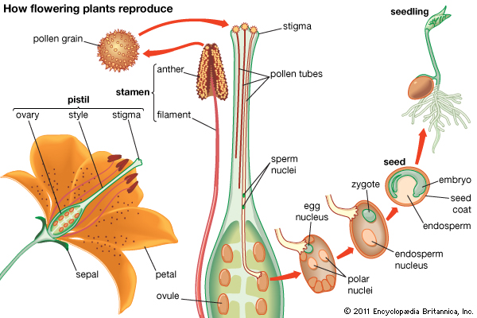
Let's play the flower parts puzzle
https://kids.britannica.com/students/assembly/view/53831

Slide 24
Pollination
What do you understand by “pollination”? Who makes it happen?
Watch this beautiful video
Make a list of organisms that visit the plants?
What are they doing when they visit the plants?

Slide 25
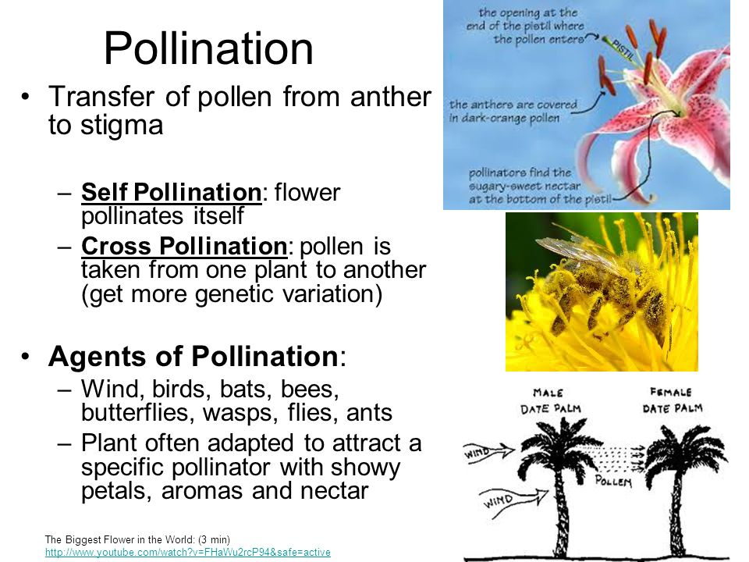
https://slideplayer.com/slide/5810734/

Slide 26
Seeds Dispersal
Seed dispersal is the movement, spread or transport of seeds away from the parent plant.
Plants have limited mobility and rely upon a variety of dispersal vectors to transport
There are five main modes of seed dispersal: gravity, wind, ballistic, water, and by animals

Slide 27
Criterion B
Plan an investigation to see which flower gets the maximum number of pollinators in your garden?
Frame a research question:
Make a hypothesis (I predict that….because…….)

Slide 28
Criterion B
Identify the variables:
List materials and quantity:
Dependent Variable | What are you measuring? | How will you measure it?
Independent Variable | What are you changing? | How will you change it?
Control Variable | What are you keeping the same? | How will you keep it the same?

Slide 29
Criterion B
Write down the steps (start each step with a verb)

Slide 30
Criterion C
On Wednesday morning in the Science class, collect data about the number of pollinators visiting each flower.
Make a data table presenting the number of pollinators each type of flower got

Slide 31
Criterion C
Describe what you observed while collecting data.
Describe what you see in the data table.
Evaluate your method.
What went well:
What went wrong:

Slide 32
Criterion C
Is your data reliable (hint: repeats and right tools)
What can you conclude from the experiment?
What could be a scientific reason for your results?
Rubric:

Slide 33
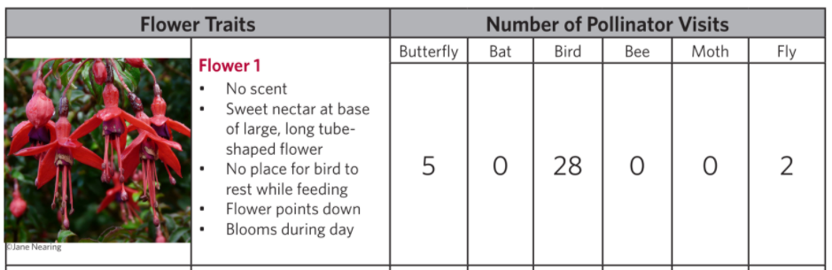
Improvements from Previous Cri. C Assessment
Data analysis
  Avoid one line answers. For example: if you are asked to analyze the following:

Slide 34
Good data analysis: The data table shows that the number of pollinator visits (DV) in flower 1 (IV) range from 0 to 28. The least number of pollinator visits, i.e. 0 visits were made by bats and bees. Two visits by flies and five visits by butterflies were made. The maximum number of visitors seen were birds (28). A general pattern is that the smaller insects such as moths, butterflies, bees, etc. don’t seem to visit the flower.

Slide 35
Example for writing about data reliability: The data may not be reliable because observations were taken only on one day for 30 minutes in a small home garden. Taking the same set of observations on more days would have made the data more reliable. (remember: repeats)
Example for writing validity of the method: The method may not be valid as the measurements were taken by watching and counting the pollinator visitors. There are specific tools to count pollinators (e.g. a quadrat). The data could be made more reliable using a correct tool for measurement.
The experiment was not a fair test, there were unequal number of flowers in the garden. (remember: correct tools, correct measurements, and fair test)

Slide 36
Example for writing conclusion:
The data matches the hypothesis because……
The data does not match the hypothesis because…..
The experiment is inconclusive because…..

Slide 37
Example of improvements:
Do not write: confused, forgot materials,, managed my time badly, I didn’t know what to do, etc.
Write: use better tools, conduct more repeats, perform the experiment in a big, open garden, choose a garden with approximately equally distributed types of flowers, etc.

Slide 38
Bee Movie - Power of Pollen
Watch the following videos:
https://www.youtube.com/watch?v=ir_-ia2dTRc
https://www.youtube.com/watch?v=oNWAiWBup2Q&list=RDoNWAiWBup2Q&start_radio=1
Take notes as you watch the video:
  What are the bees collecting from the flowers
  What are they doing with the material collected from the flowers
  What type of pollination is this?
  How is this different from any other form of pollination (include advantages and disadvantages)?

Slide 39
Summarizing the Unit - Check Your Understanding
Difference between sexual and asexual reproduction
Types of asexual reproduction
Parts of a flower (female and male parts)
Fertilization
Pollinators
Pollination (self and cross pollination, insect and wind pollination)

Slide 40
Complete End of Unit Reflection

